Slide 1
Chesapeake Conservation and Climate Corps
FY26 Corps Mini Grant Information Session
stolliver@cbtrust.org

Slide 2

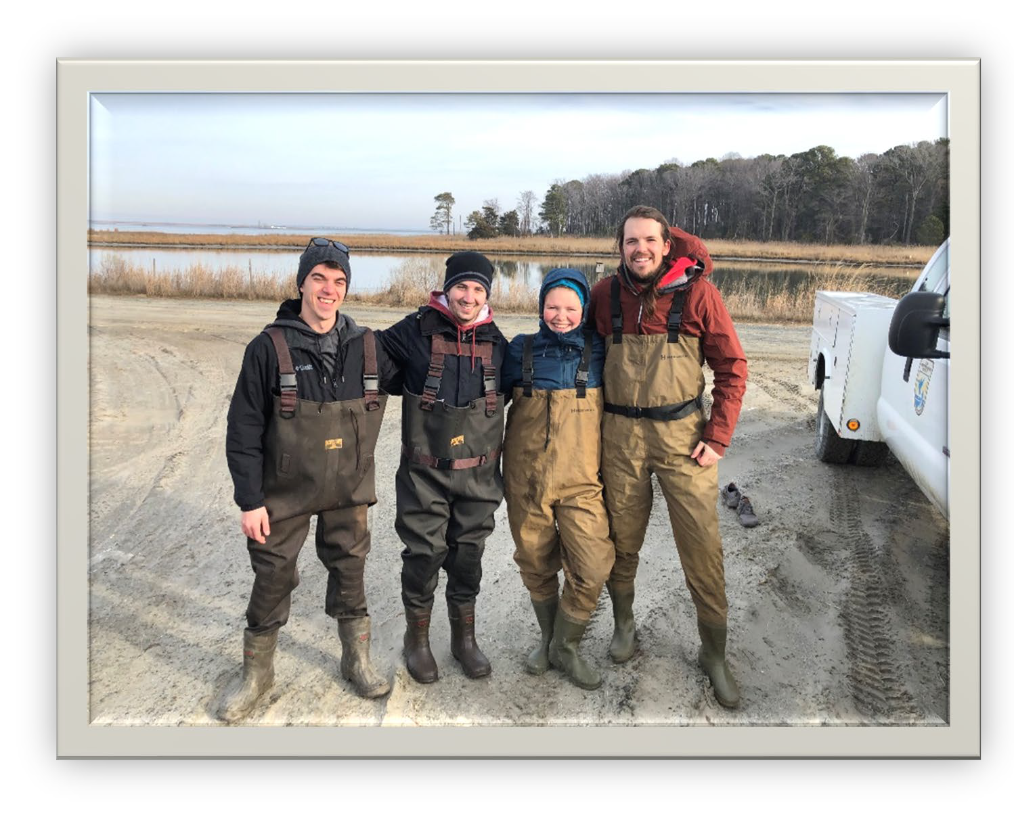
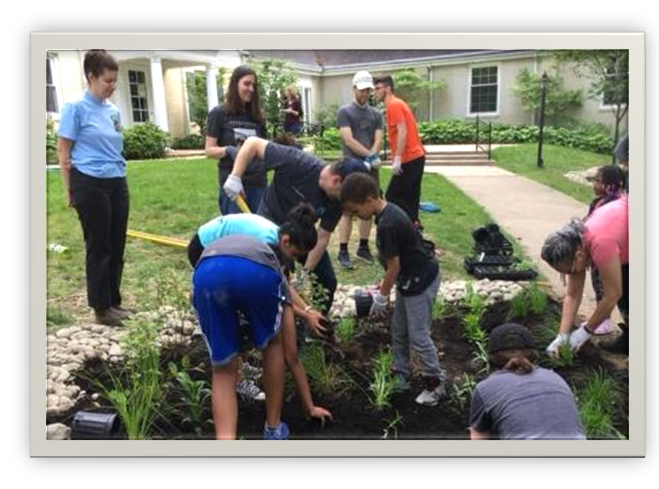
Agenda
Mini Grant
Overview
Grant Life Cycle
Basic Information
Application Instructions
Tips For Success
Resources
ALL Hands-On Deck
Application Information
Potential Projects

Slide 3
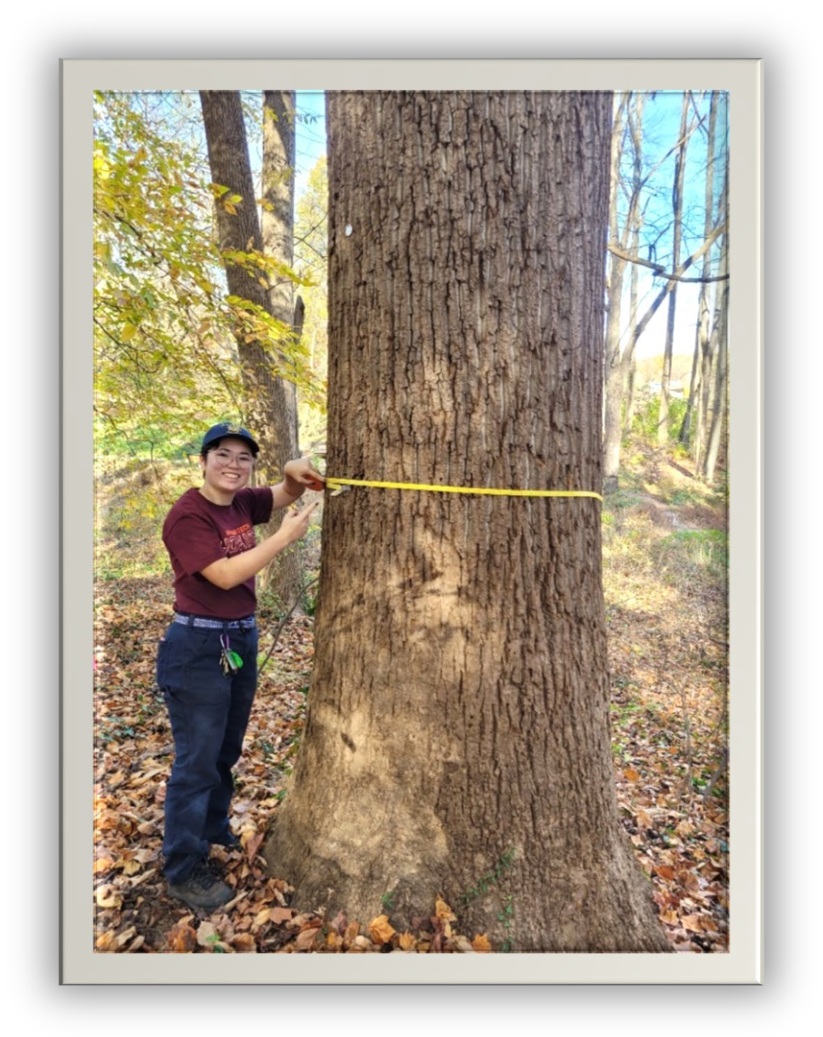
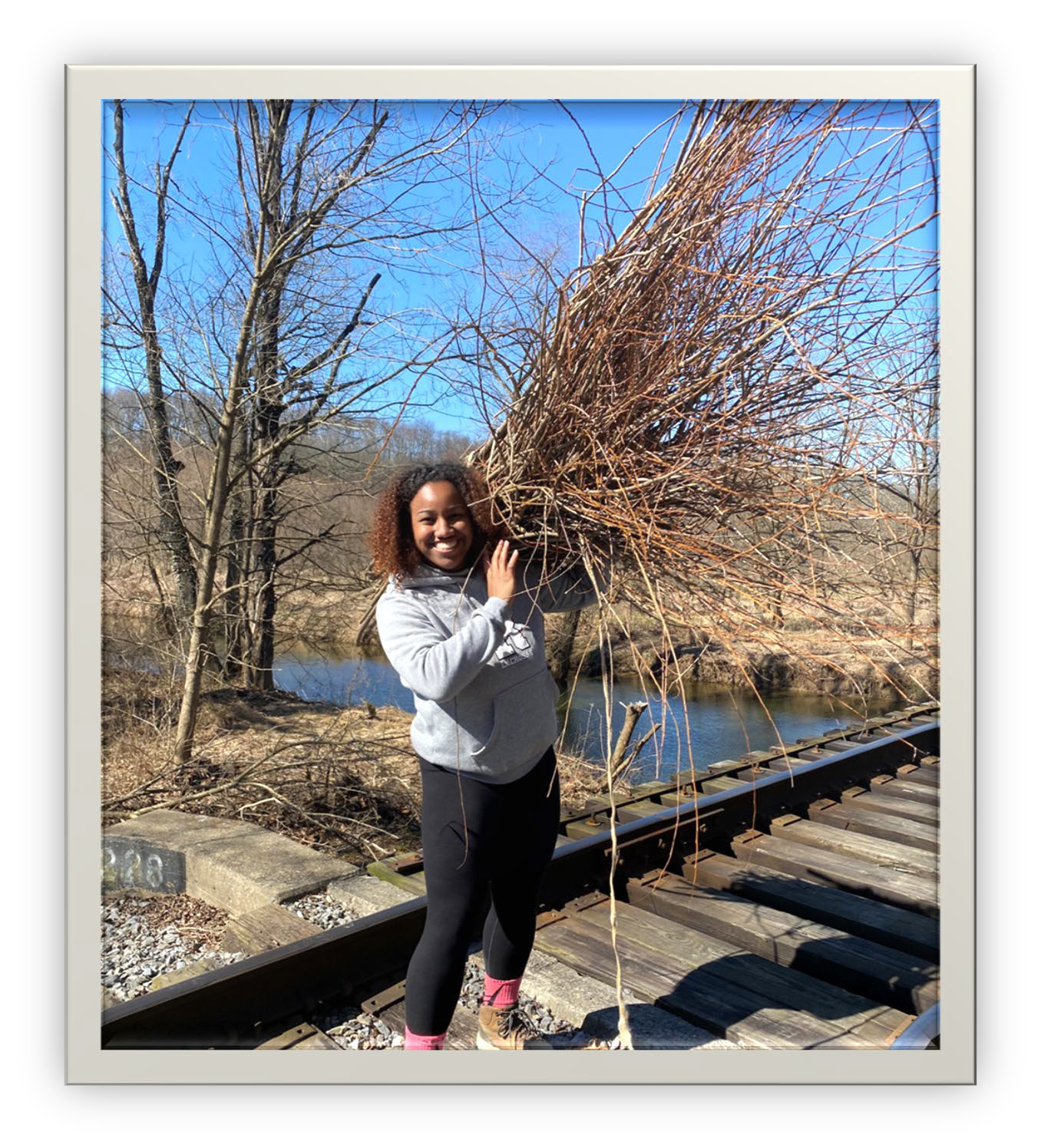
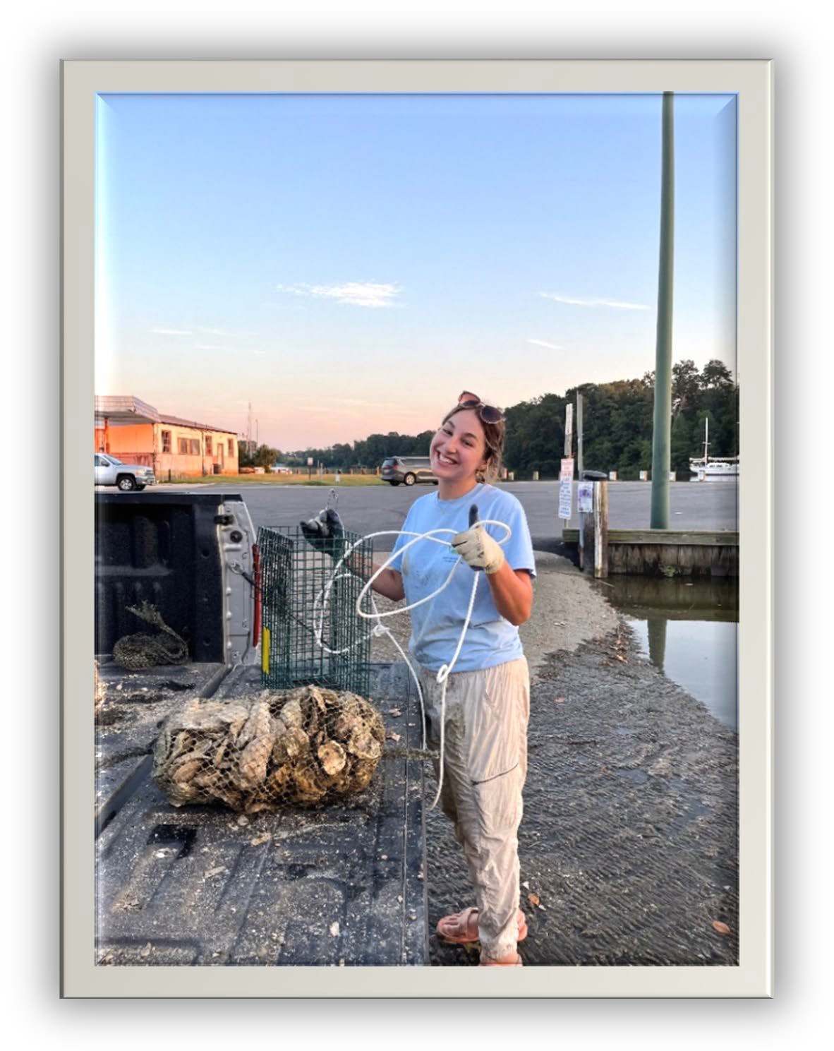
Mini Grant Program
The Corps Mini Grant Program is designed to fund projects managed by Chesapeake Conservation and Climate Corps Members that engage residents in projects and programs that increase stewardship ethic of natural resources through on-the-ground restoration, environmental education and outreach and community engagement activities for the restoration and protection of the Chesapeake Bay and its rivers. The mini grant is designed to support a project being led by a Corps member.
Deadline: March 27, 2026, at 4:00pm EST
Funding level: Up to $1,250

Slide 4





Mini Grant Life Cycle
2025-26 Application Process & Timeline
Advertisement & Outreach
Ongoing
Online Grant Application Process
Must submit 8 weeks prior to project start date
Review by Internal Review Committee
Primary and Secondary reviewers
No Reimbursement Funding
Do not start spending funds toward the project until you’ve been approved
Award Letter & Contingencies Sent
Submit signed letter and contingencies to receive payment(s)
Decision Announced
~8 weeks after submittal
Commence Project!
Keep us in the loop of changes and take photos!
Final Report
Timeline varies, all project reports will be due before the end of the Corps term.

Slide 5

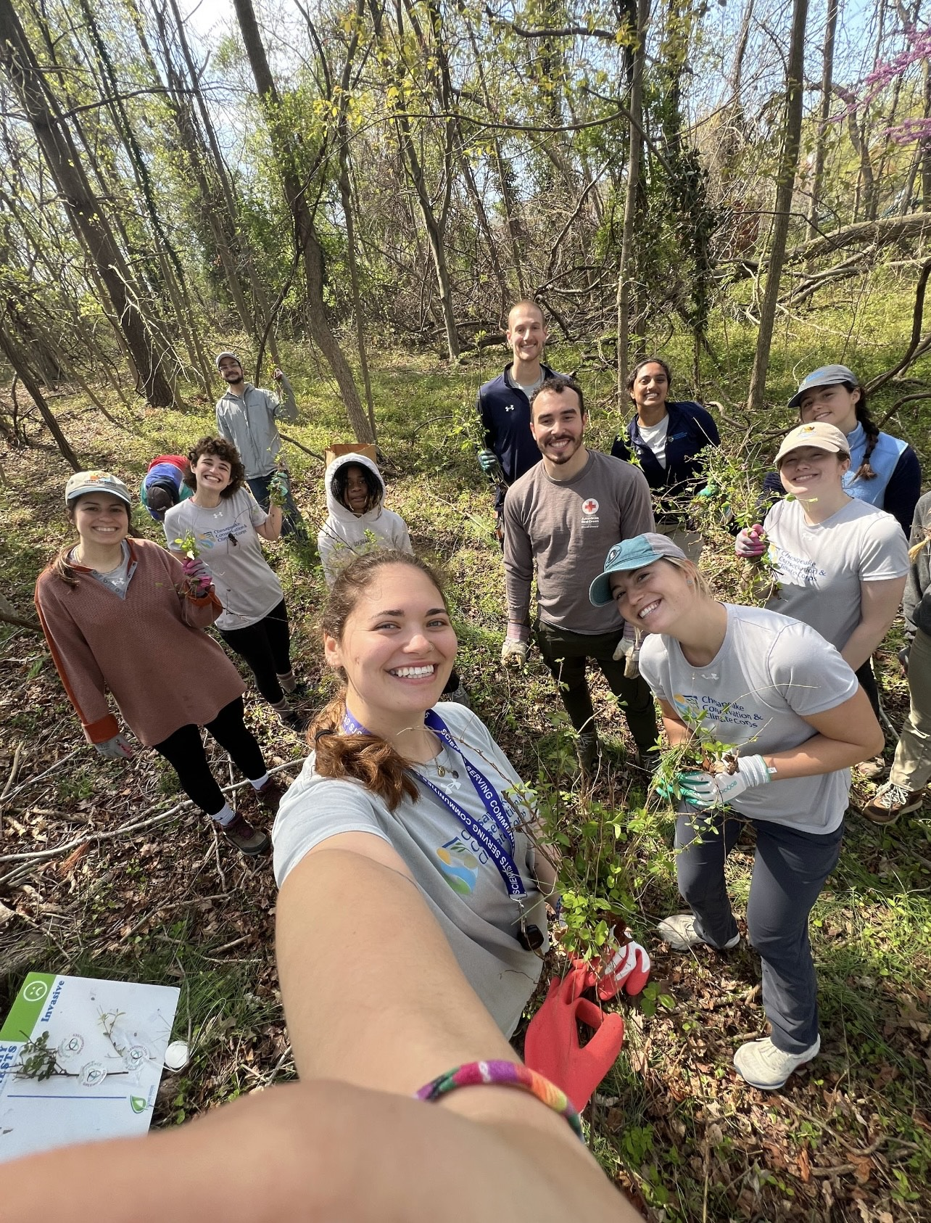
Mini Grant: Basic Information
An Executive Officer and Project Leader MUST be identified for all proposals and must be different individuals.
The Applicant email address MUST be the same email address as the project leader email address (Typically the Corps Member)
The Trust MUST receive all proposals eight weeks prior to the start of the proposed project as the trust cannot reimburse your organization for work that has already been completed.

Slide 6
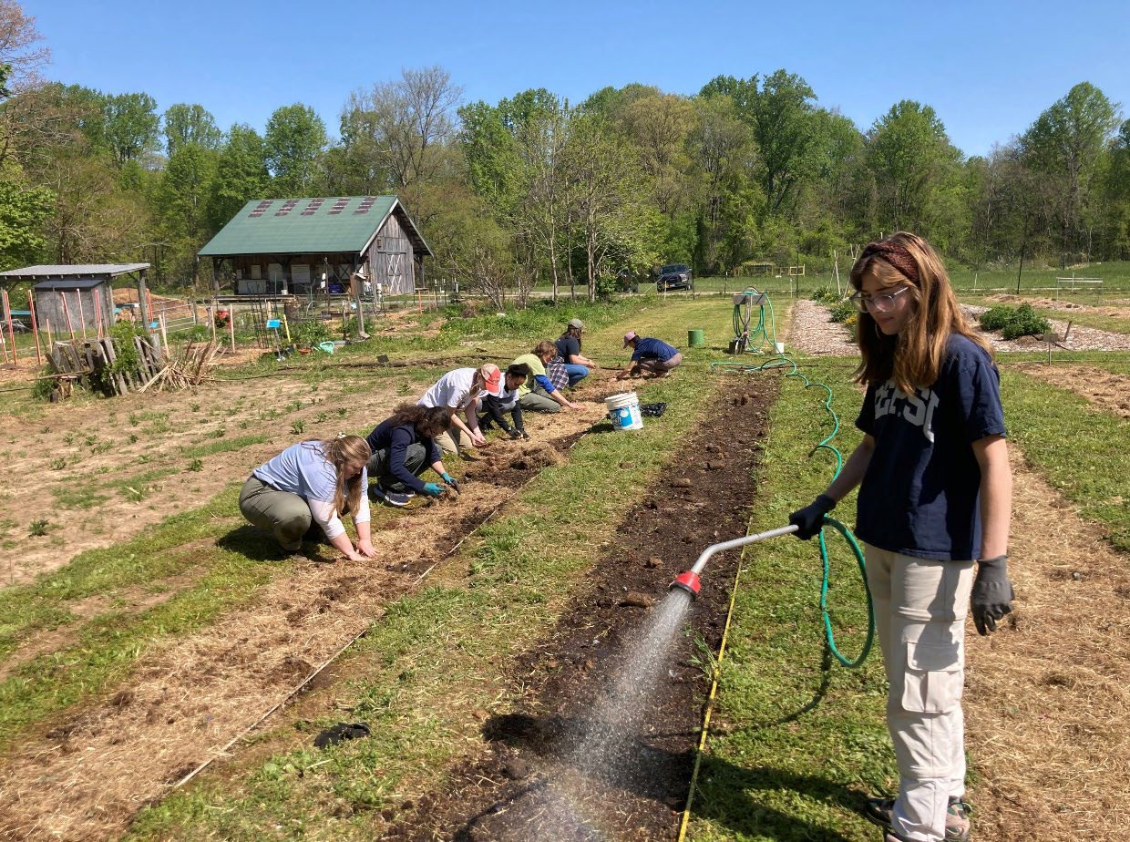
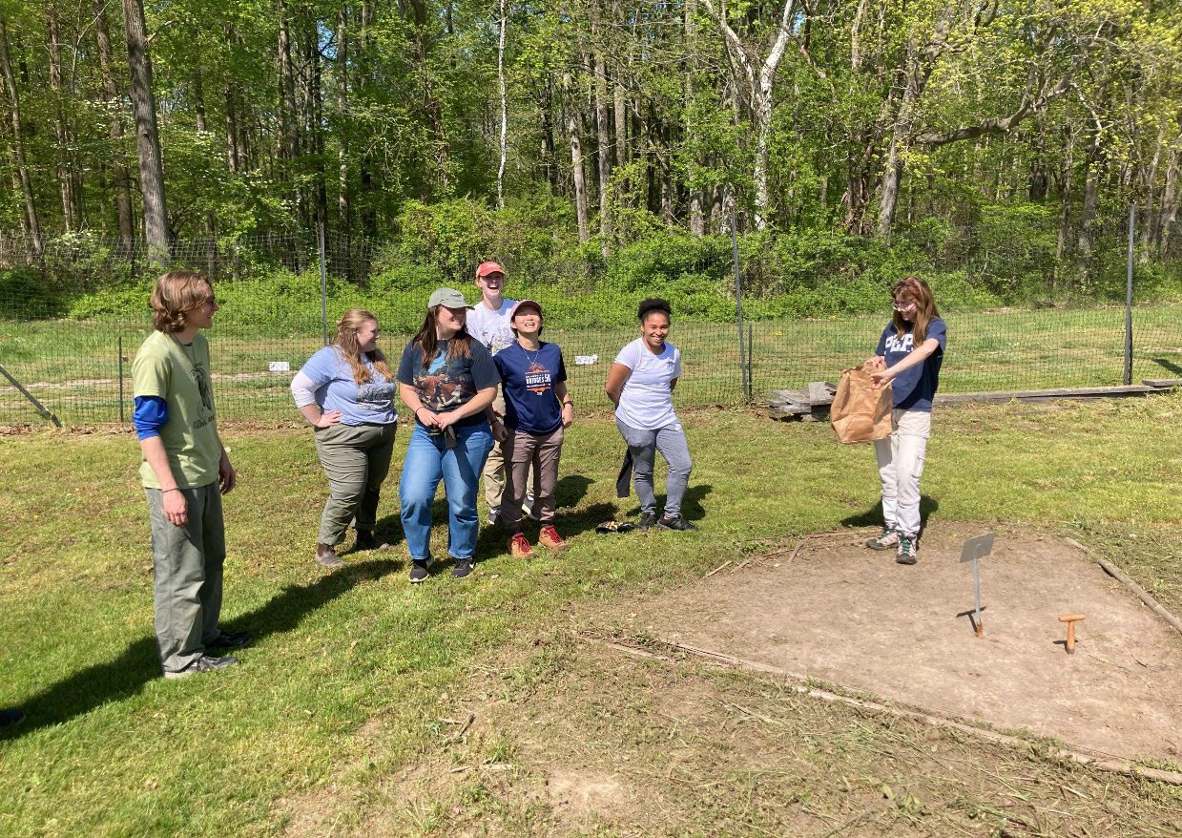
Mini Grant: Basic Information
Generally grants should be awarded to the Host Org
There are a few exceptions here, and if you have concerns, reach out to Sydney directly.
Projects MUST be completed, and final reports submitted to the Trust two weeks before the end of the Chesapeake Conservation and Climate Corps term of service on August 18, 2026 or earlier.

Slide 7
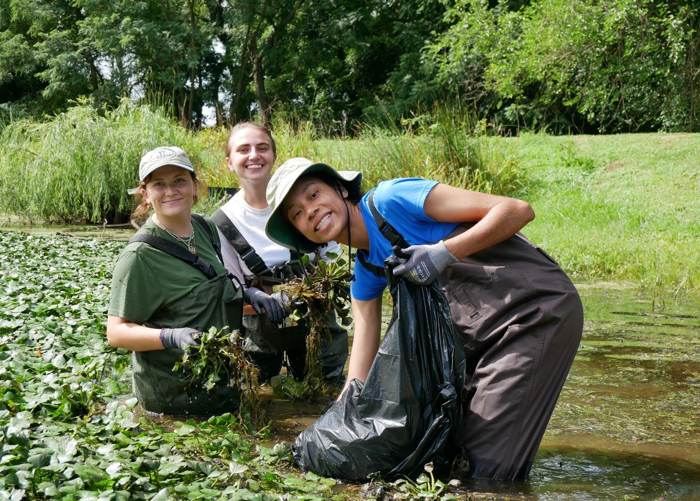
Sample Eligible Project
Stream or watershed clean ups
Storm drain stenciling
Workshops promoting watershed restoration, energy conservation, agricultural, and forestry best practices
Watershed education events
Water quality monitoring projects involving volunteers
Materials promoting Bay awareness
Rain gardens and rain barrels
Streamside forest buffers
Stormwater wetland enhancement
Schoolyard habitats
Invasive removals

Slide 8
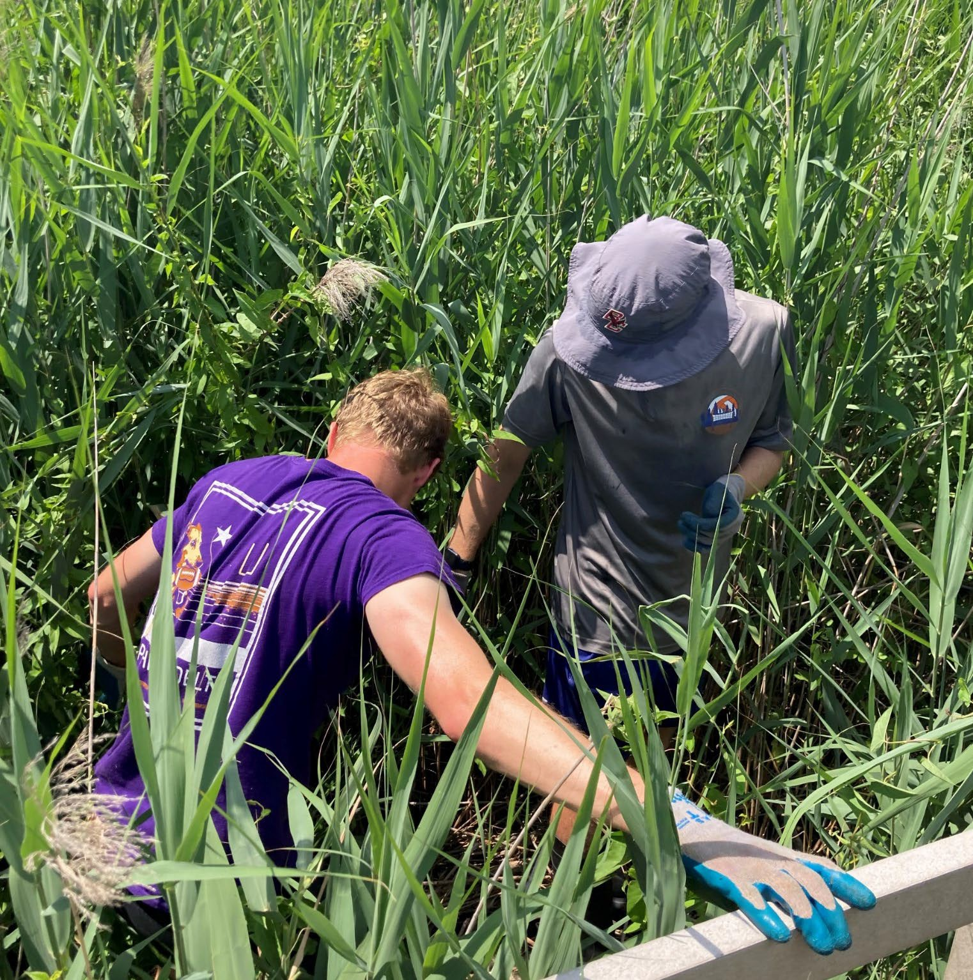
Sample Eligible Project
Green Schools projects
Energy efficiency projects, including audits and energy conservation implementation
Sustainable agriculture or agricultural stewardship projects
Civic Action (town meetings, voting, writing elected officials/decision makers)
Community engagement (outreach, presentations, social media, messaging at community events/fairs/festivals, event-organizing, mentoring, PSAs, flyers, posters)
Community outreach campaign promoting watershed restoration, energy conservation, agricultural, and forestry best practices

Slide 9
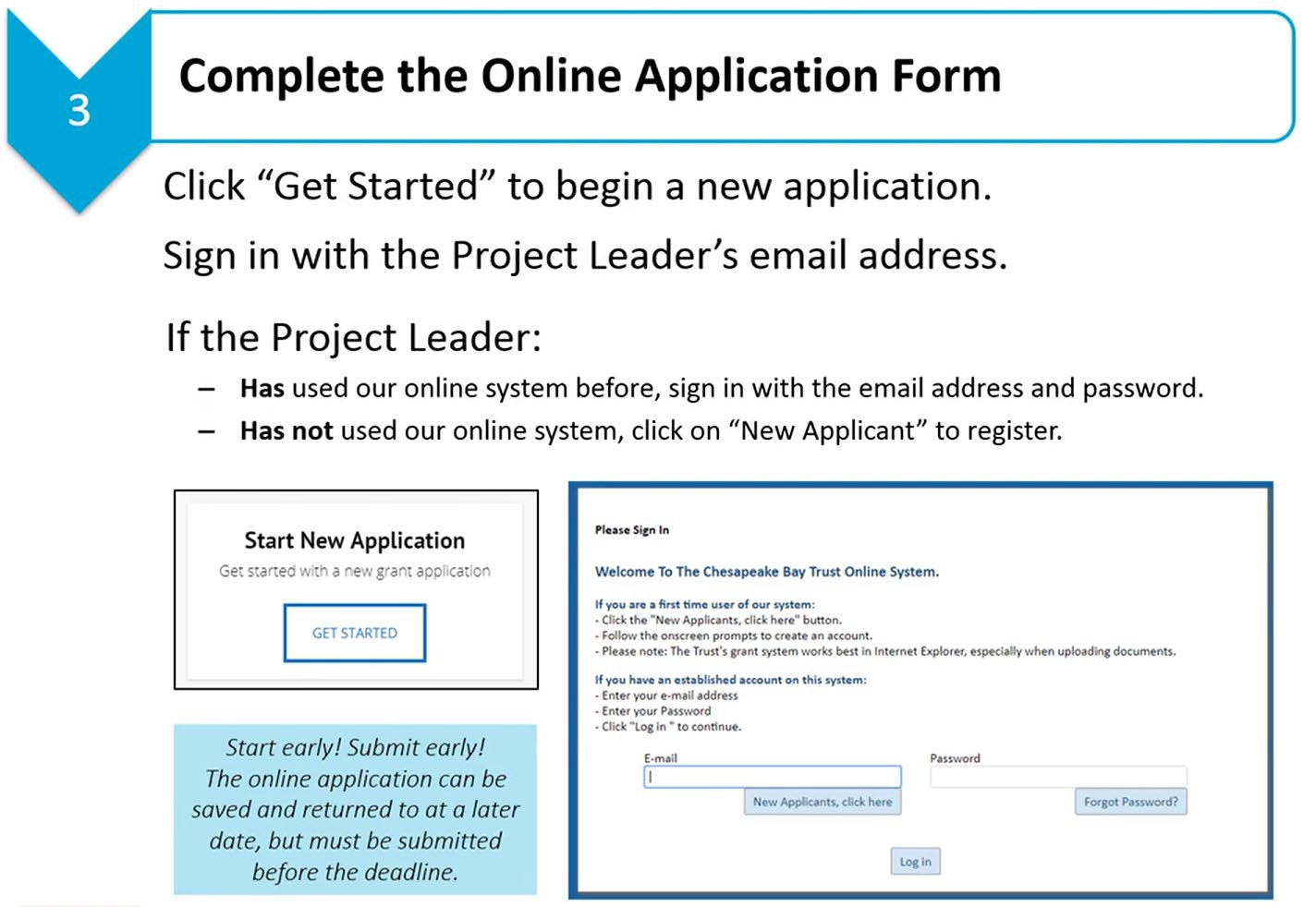
Application Instructions
Narrative
Uploaded Word Document
Be Clear and Concise!
Budget
Uploaded Financial Management Spreadsheet
Information is Recorded in Online Application
Be Detailed!
Submittal
Double-Check!
We Now have a Webinar!
How to apply for a Chesapeake Bay Trust Grant: https://vimeo.com/347338078
Website Link:
Corps Mini Grant - Chesapeake Bay Trust (cbtrust.org)

Slide 10
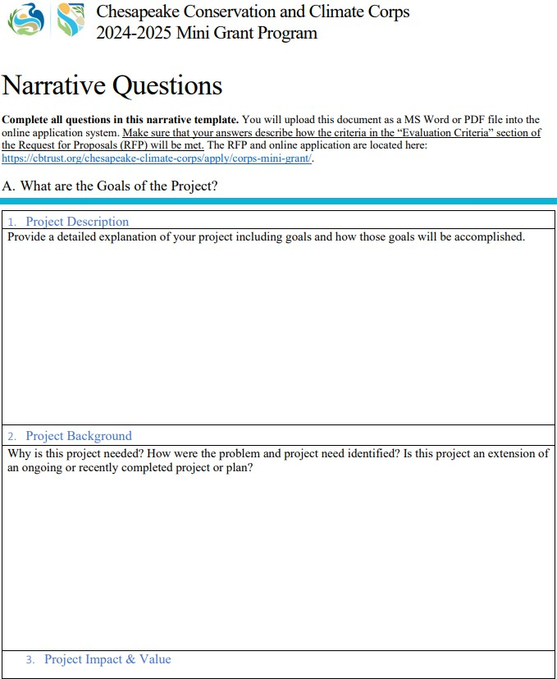
Application Instructions
Narrative Questions can be found on our website: https://cbtrust.org/chesapeake-climate-corps/apply/corps-mini-grant/

Slide 11
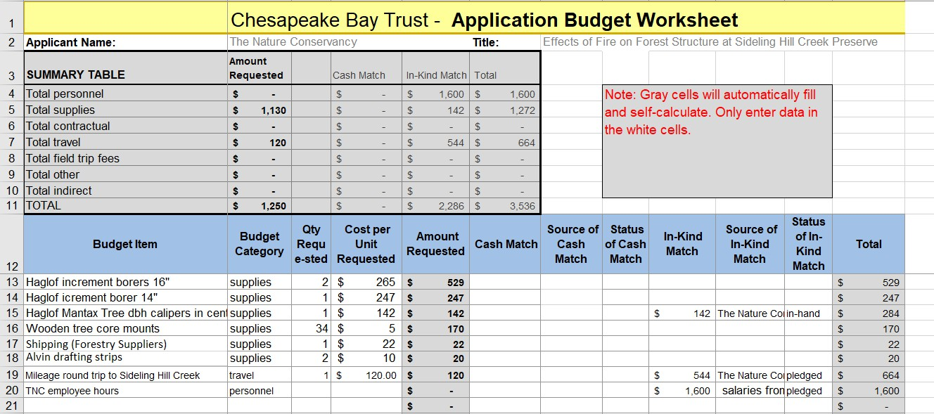
Financial Management Spreadsheet

Slide 12
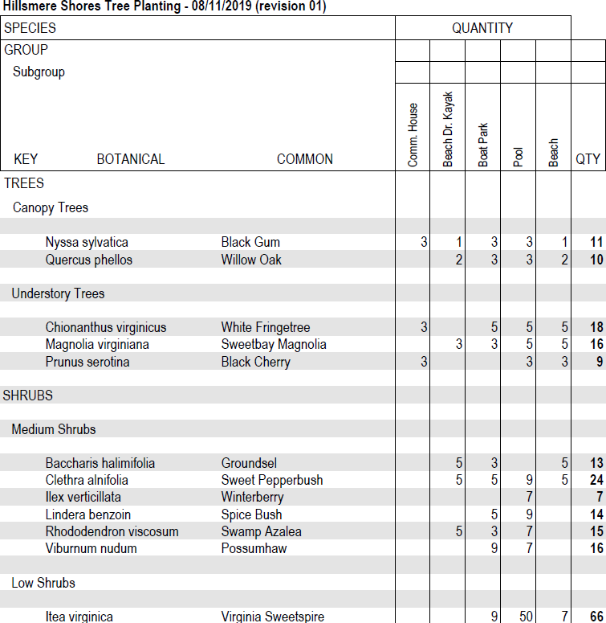
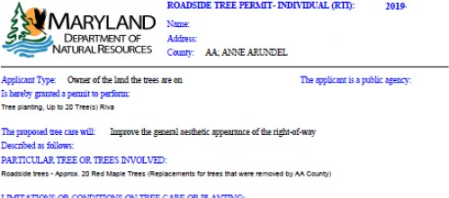
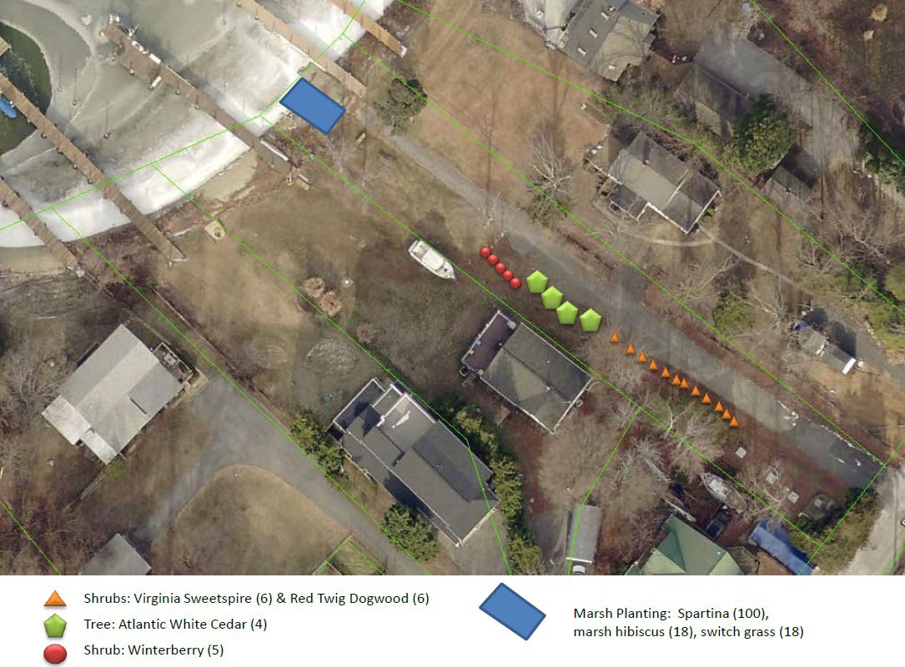
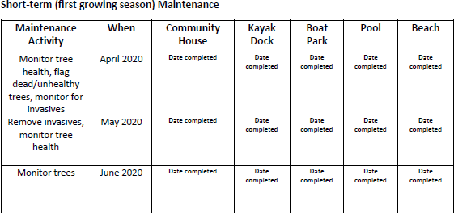
Supporting Documents
Site Visits
Letter of Permission
Letter of Commitment
https://cbtrust.org/wp- content/uploads/Chesa peake-Bay-Trust-Letter- of-Commitment- Policy_082819.pdf
Native Plant List
Permit Status
Site Design
Site Design
Native Plant List
Maintenance Plan
Draft Agenda
Permit Status
Maintenance Plan

Slide 13
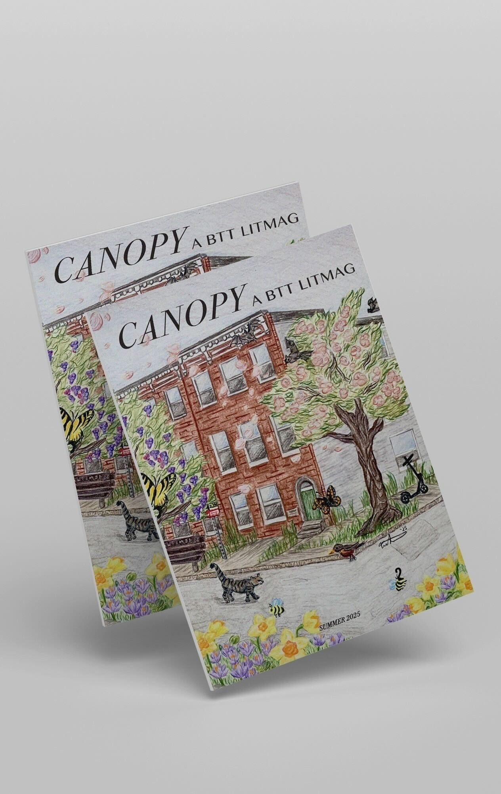
Mini Grant Examples 2025-2026
Henry Haney- Baltimore Tree Trust Literary Magazine
This published magazine featured poetry, fiction, and creative nonfiction submissions from local writers entitled ‘Canopy: A BTT LitMag.’ The publication explored the intersection of people, trees, nature, and city in and around Baltimore.
Canopy’ published 18 pieces of prose and poetry from 16 individual writers with cover art by a local botanical illustrator
The publication was celebrated at an in-person event in partnership with Peabody Heights Brewery.

Slide 14
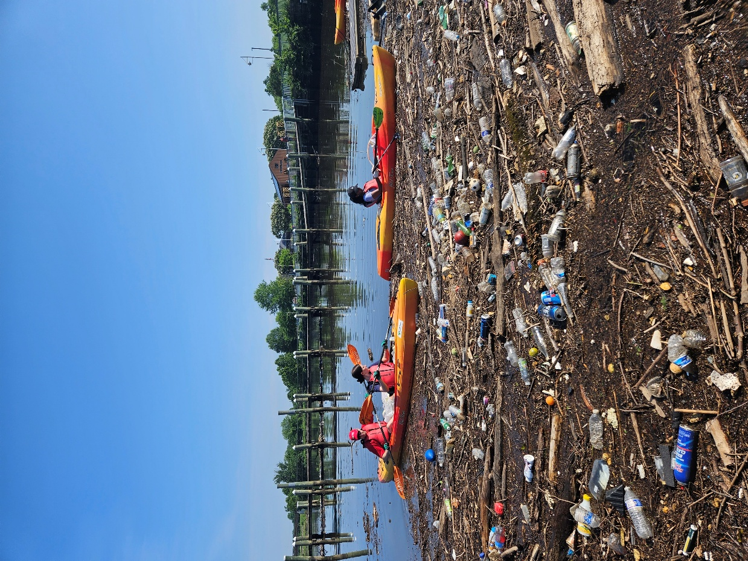
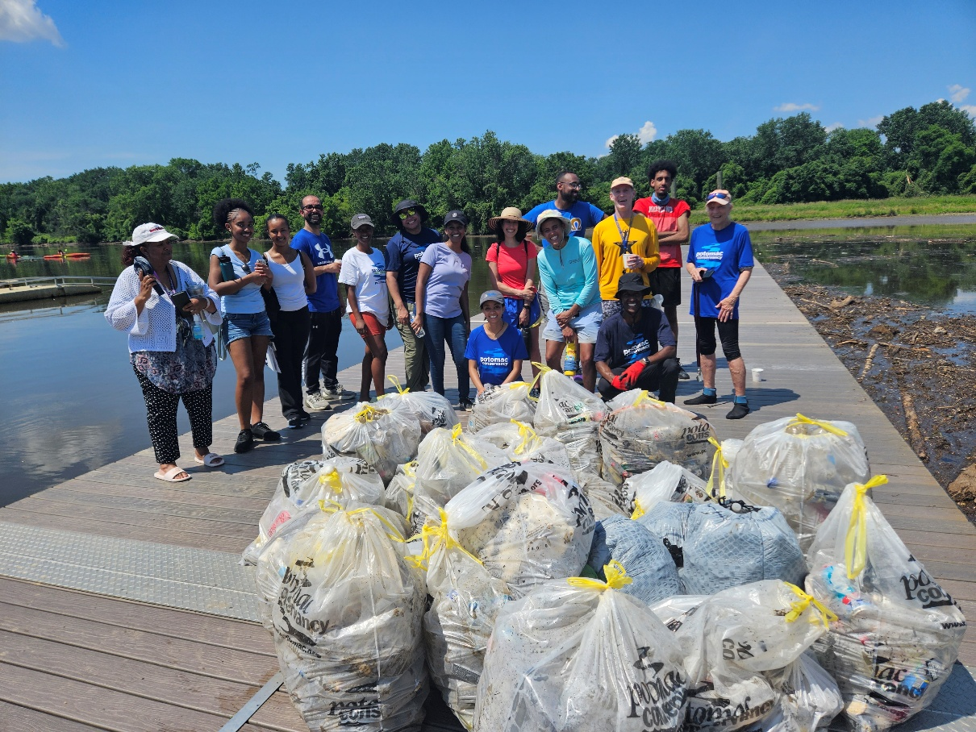
Mini Grant Examples 2024-2025
Feben Abebe- Potomac Conservancy
Scoop and Paddle on the Potomac
The Scoop and Paddle on The Potomac project, at Potomac Conservancy, focused on establishing a kaya waterway clean up program focused on litter removal and connecting faith-based organizations to environmental stewardship
Establishing trash clean-up protocol
Assisted in educating volunteers on innovative trash solutions.

Slide 15
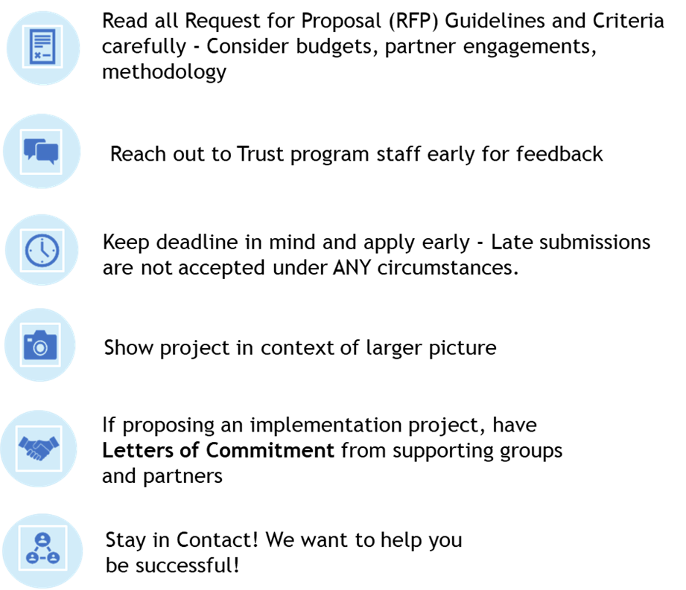
Tips For Success

Slide 16
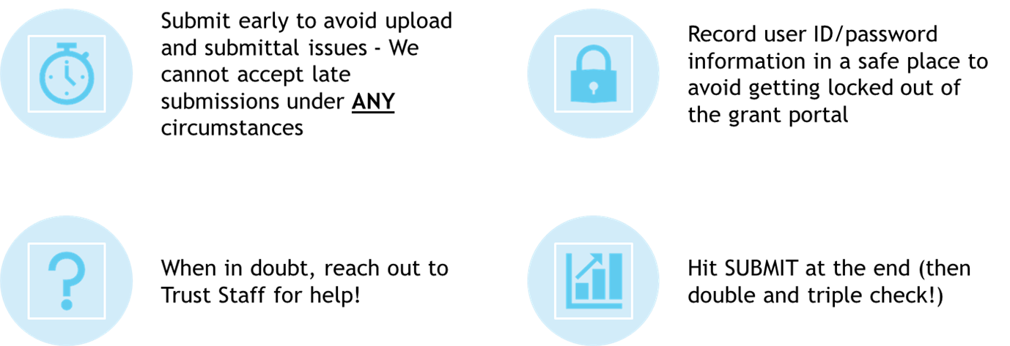
Tips For Success

Slide 17
Resources
How to Apply for a Chesapeake Bay Trust Award: https://vimeo.com/347338078
How to use the Financial Management Spreadsheet: https://vimeo.com/281495436
How to Manage a Chesapeake Bay Trust Award: https://vimeo.com/400210113

Slide 18
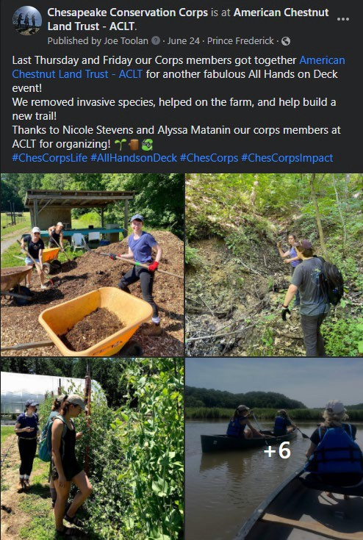
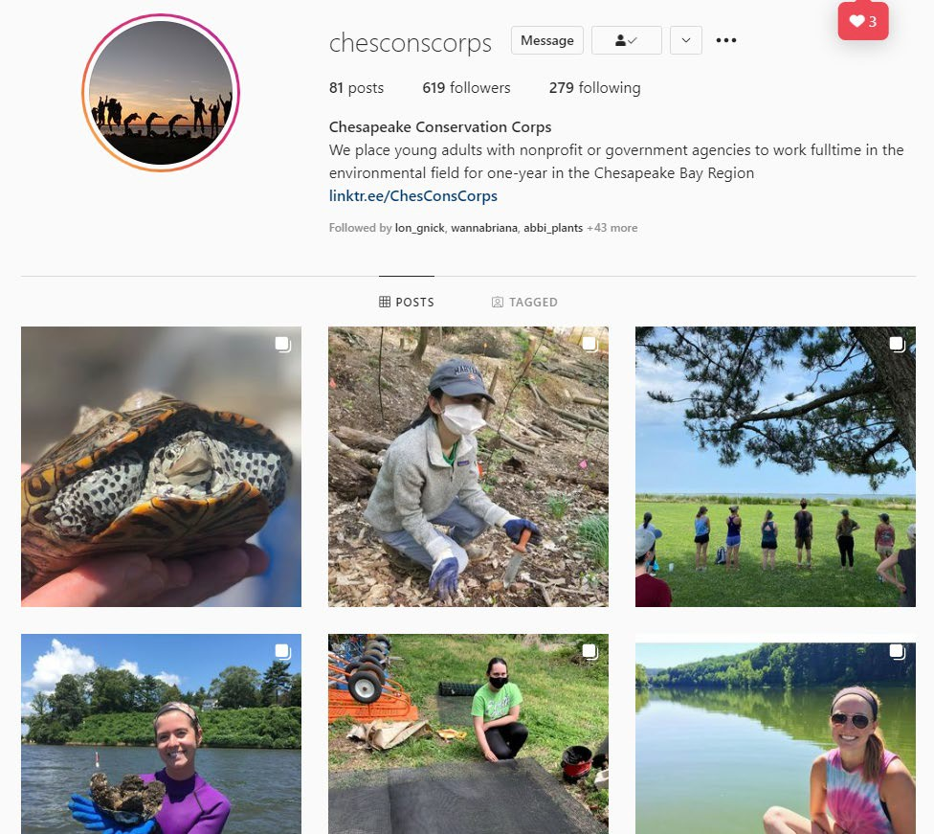
Make Sure to send us your stories, pictures, and videos to Share and Highlight!

Slide 19

Questions?
Program Coordinator: Sydney Tolliver, stollliver@cbtrust.org, 410-974-2941 ext. 137
Thank You!
For more information visit
cbtrust.org

