Slide 1

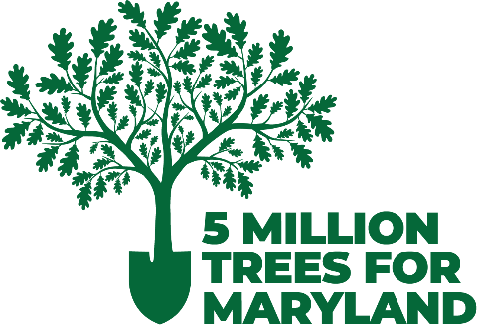

Urban Trees Grant Program
Information Session
Learn more at cbtrust.org/grants/urban-trees
We will begin momentarily. This webinar will be recorded and posted on our website/shared with those who were unable to attend.

Slide 2
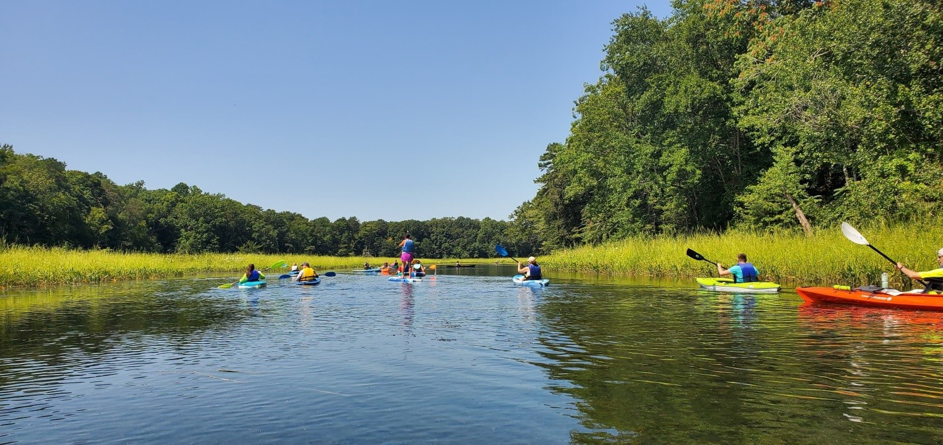



About the Chesapeake Bay Trust
The Chesapeake Bay Trust is a nonprofit grantmaking organization dedicated to improving the Chesapeake, Coastal Bays, and Youghiogheny watersheds. Our mission is to restore and protect our natural resources by focusing on three core objectives: environmental education, community outreach, and on-the-ground restoration.
Each year, the Trust awards millions of dollars in grants to support healthier local communities and a cleaner environment. We engage more than 250,000 individuals annually who are making a positive impact on our waterways and the natural resources of our region.
We believe that empowering people to take action is the key to protecting forests, streams, rivers, bays, wildlife, and more—right in their own communities.

Slide 3

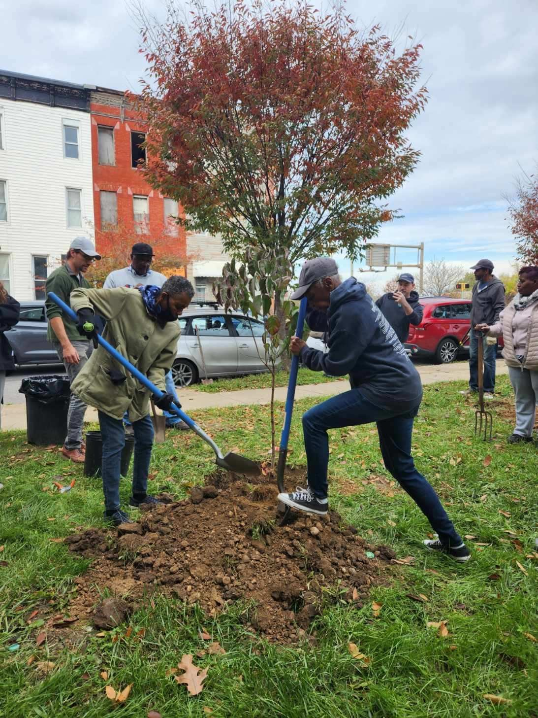
Agenda
Grant Program Overview
Review Request for Proposals (RFP)
Application and Review Process
Resources
Questions/Answers
Franklin Square Community Association
cbtrust.org

Slide 4
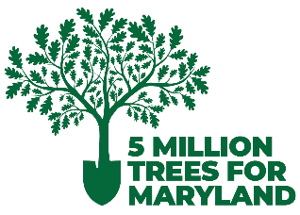
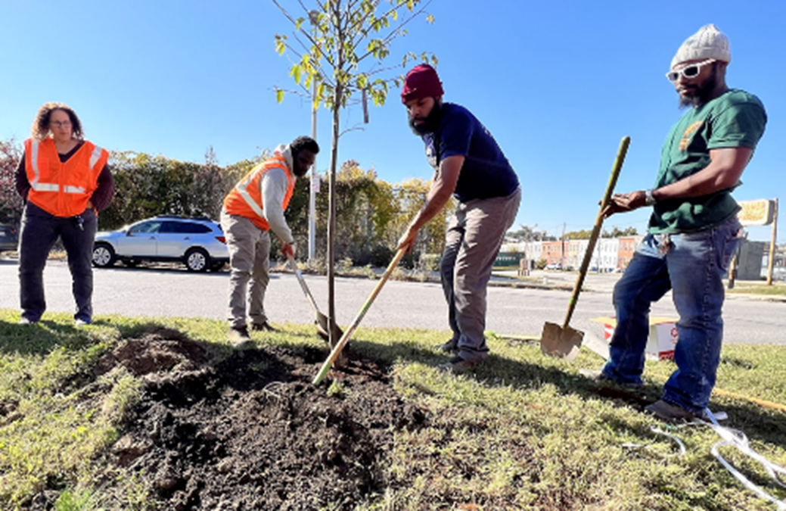
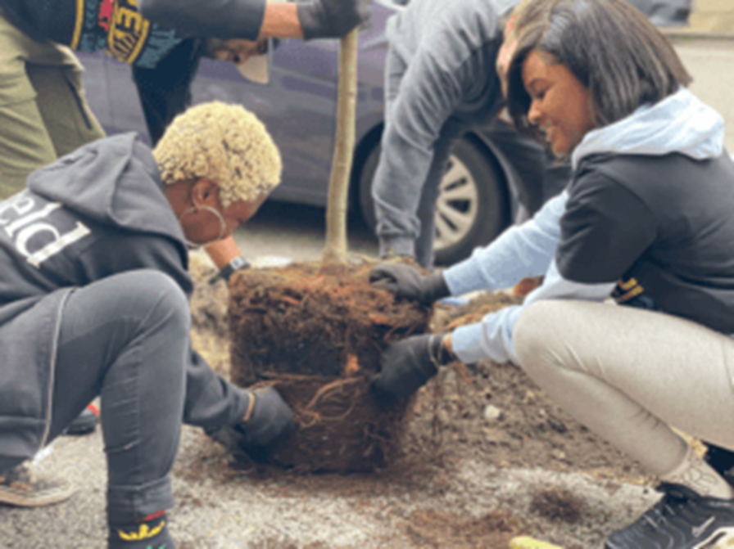
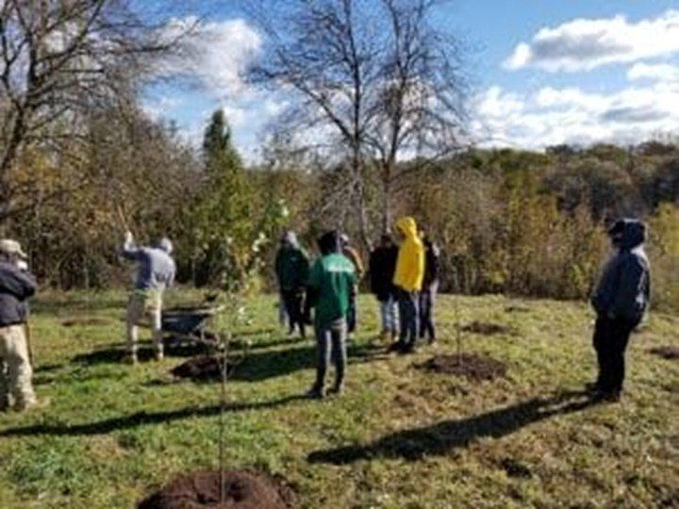
The Urban Trees Program
Originated in the Tree Solutions Now Act of 2021
Called for by the Maryland General Assembly as a component of the 5,000,000-tree goal by 2031 towards planting 10% in urban underserved areas.
Funds are for planning, implementing, and maintaining trees (as per statute).
cbtrust.org

Slide 5
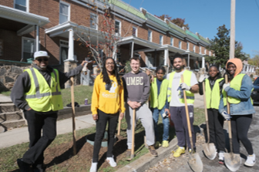
Why urban trees?
  Improve the health of local waterways and the Chesapeake Bay
  Reduce risk of heart disease
  Improve mental health
  Mitigate flooding
  Improve air quality
  Strengthen communities
  Lower crime rates
  Boost property values
  Stimulate local green jobs
  Provide urban wildlife habitat
  Reduce urban heat island effect
Blue Water Baltimore
cbtrust.org

Slide 6
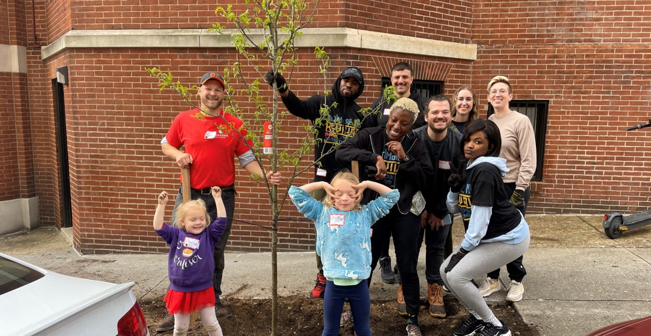
The Urban Trees Program
Made 154 grants and mini grants to plant 85,000 trees.
Contracts with nurseries to grow over 7,000 underrepresented native trees to diversify the tree canopy in urban underserved areas.
Engaged 65,000 volunteers, students, teachers, and professionals in tree planting.
Midtown Community Benefits Fund
cbtrust.org

Slide 7
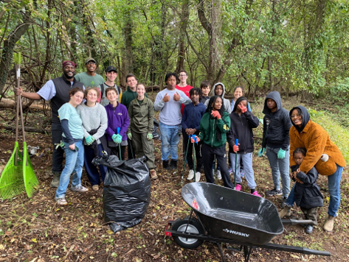
Plant trees with us!
Urban Trees Mini Grant (Rolling)
Tree planting projects for $10,000 or less
Urban Trees Grant (Deadline: March 5 at 4pm)
About $15,000 for projects in a small neighborhood of 25-100 trees
About $45,000 for multiple neighborhoods and 75-300 trees
About $200,000 for multiple communities and 300-1,000 trees
Ashburton Area Association
*Projects should aim for $600 or less per tree
cbtrust.org

Slide 8
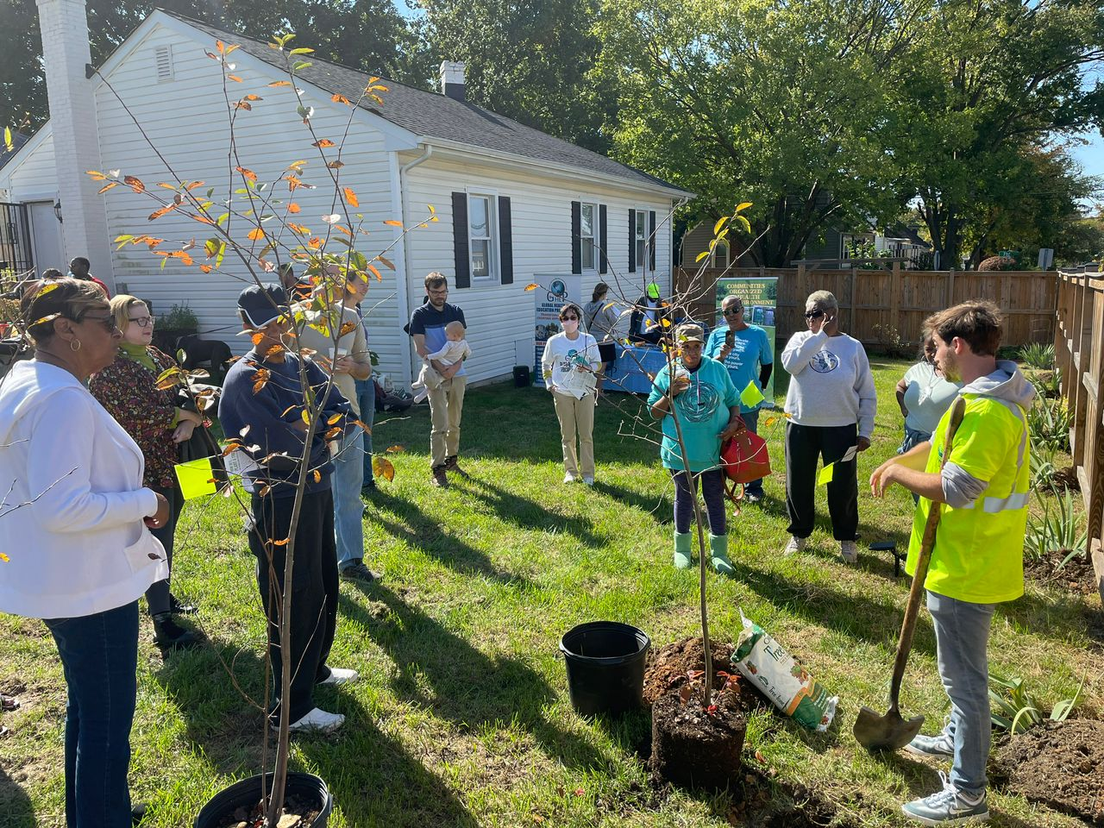
Eligibility to apply
  Non-profit organizations
  Schools and institutions of higher education
  Service, youth and civic groups
  Neighborhood/Community associations
  Counties
  Municipalities
  Forest conservancy district boards
Global Health and Education Partners
cbtrust.org

Slide 9
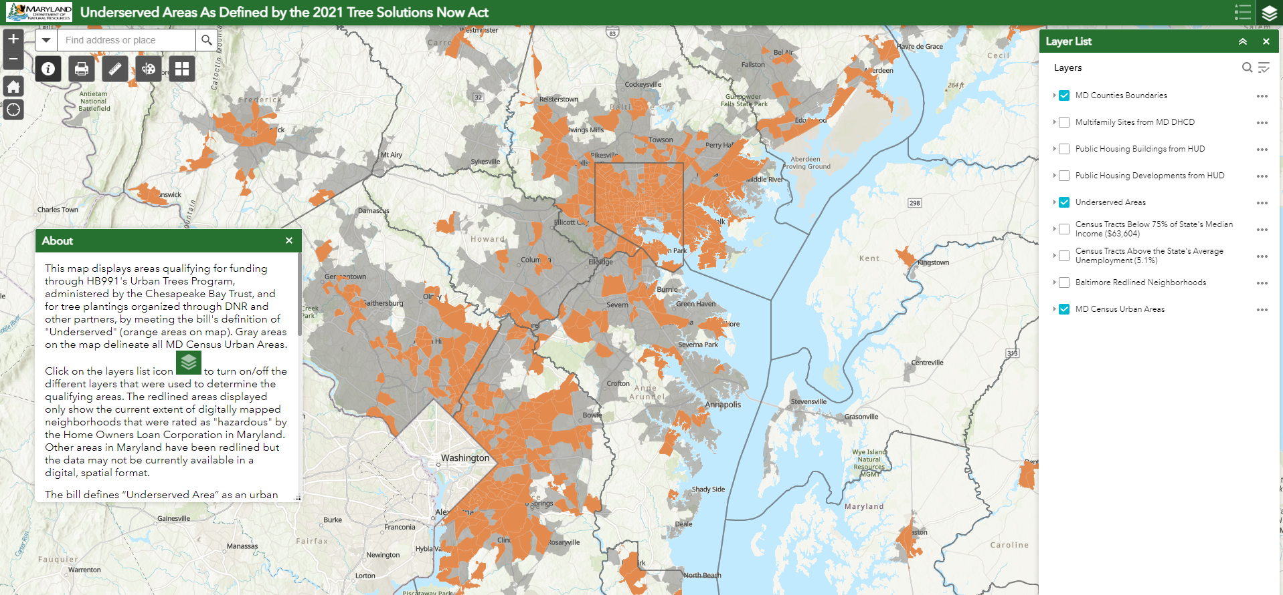
Eligible planting sites
  1. Urban and
  2. Underserved
  Historic disenfranchisement
  High unemployment
  Low income
  Housing projects*
    -(must pull up layer)
https://maryland.maps.arcgis.com/apps/webappviewer/index.html?id=4258d3e39f6a47fca146b854c0f01e31
cbtrust.org

Slide 10
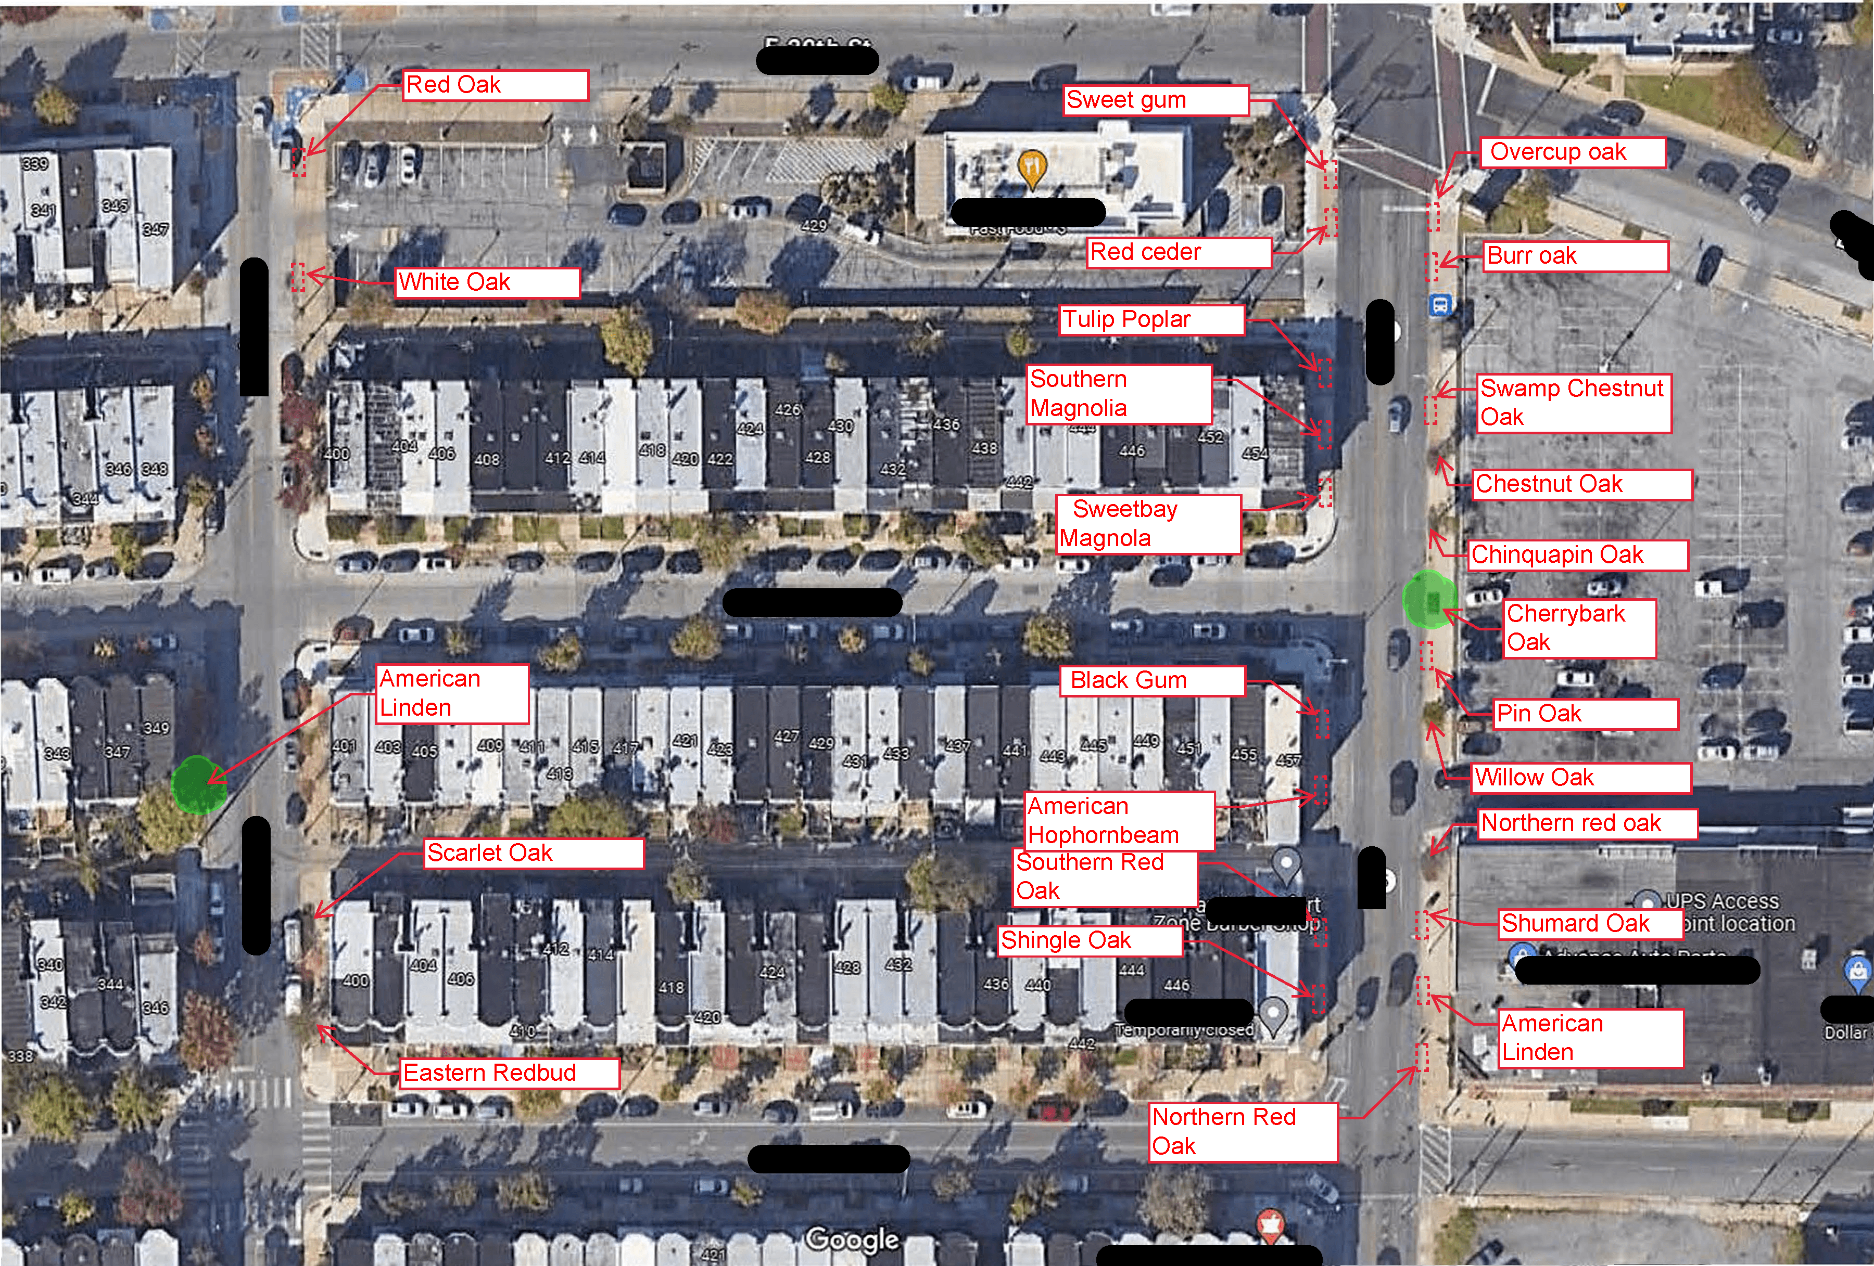
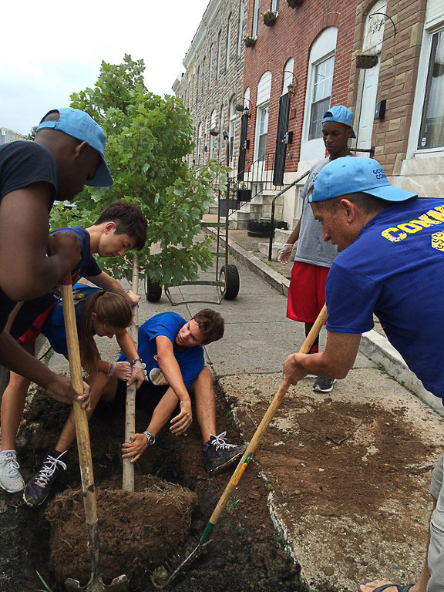
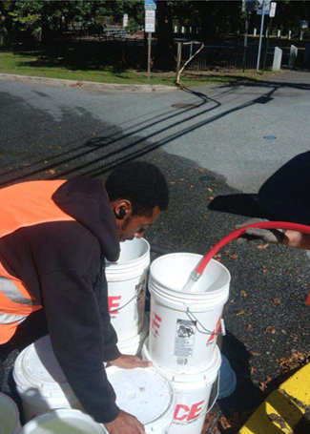
Project timeline and expenses
Phase I: Planning and outreach
Phase II: Implementation
Phase III: 2 Years of Maintenance
Permits
Planting plans
Outreach
Place orders
.
Site preparation
Planting
Staking
Protecting
Mulching
Watering
Weeding
Monitoring
cbtrust.org

Slide 11
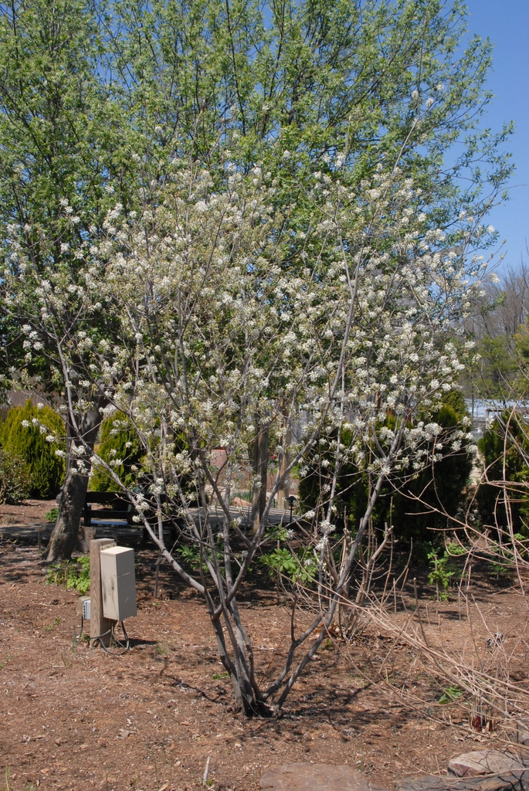
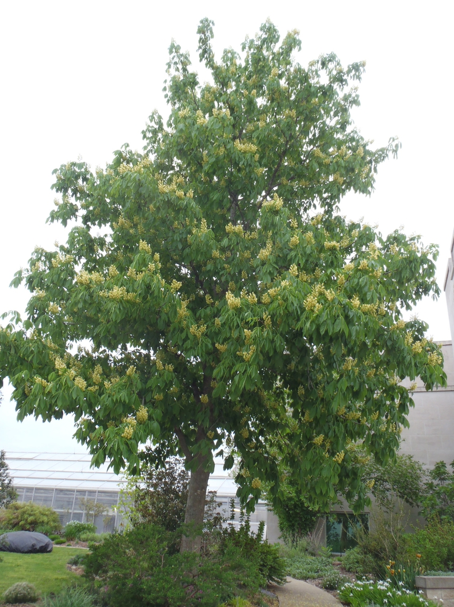
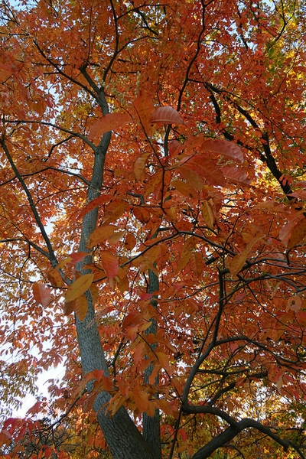
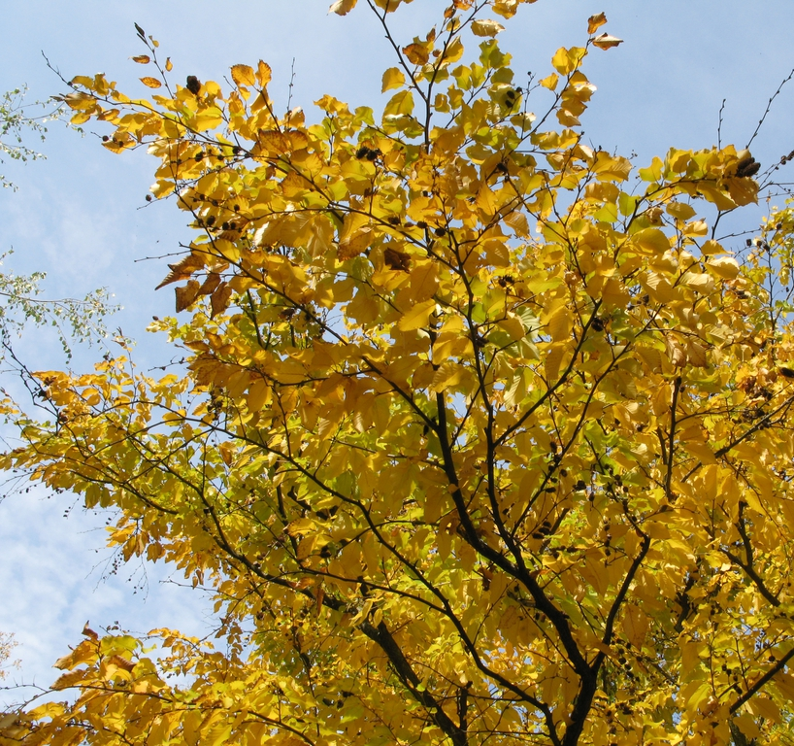
NEW! Free trees from underrepresented species
Common Serviceberry
Yellow Buckeye
Sourwood
Sweet Birch
cbtrust.org

Slide 12
7,000+ trees from 36 underrepresented species
Sugar Maple (1,400)
Yellow Buckeye (50)
Hazel Alder (330)
Common serviceberry (50)
Sweet birch (200)
Pignut hickory (160)
Shagbark hickory (140)
American yellowwood (53)
Pagoda dogwood (50)
Southern Hawthorn (52)
Kentucky coffee tree (250)
Carolina silverbell (50)
American witch-hazel (400)
American holly (500)
American hophornbeam (50)
Sourwood (50)
Loblolly pine (200)
Virginia pine (200)
Southern red oak (250)
Shingle oak (250)
Laurel oak (50)
Overcup oak (50)
Bur oak (250)
Blackjack oak (50)
Swamp chestnut oak (1250)
Chinquapin oak (250)
Water oak (103)
Cherrybark oak (102)
Dwarf chinquapin oak (50)
Shumard Oak (50)
Post oak (50)
Winged sumac (50)
Smooth sumac (200)
Northern white cedar (200)
American linden (1300)
Blackhaw Viburnum (700)
cbtrust.org

Slide 13
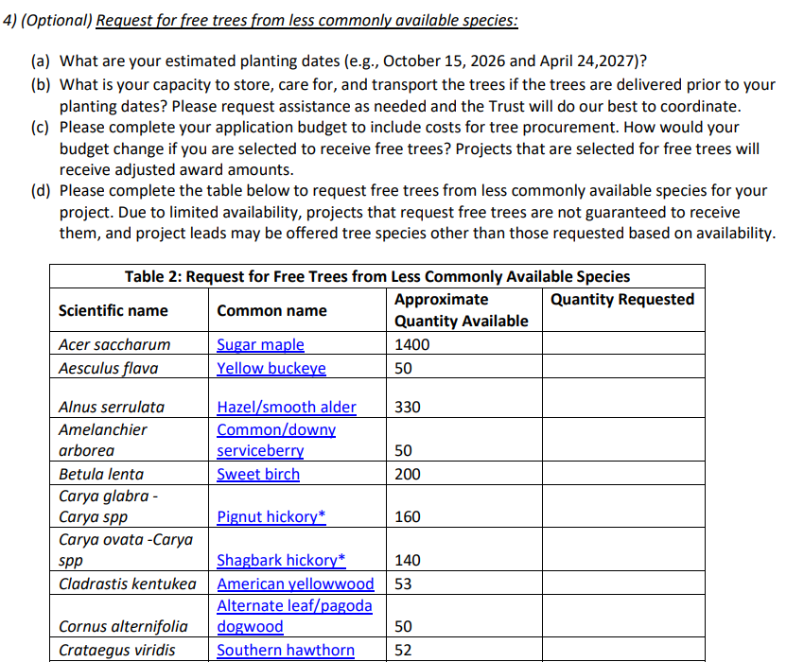
Request free trees from underrepresented species
cbtrust.org

Slide 14
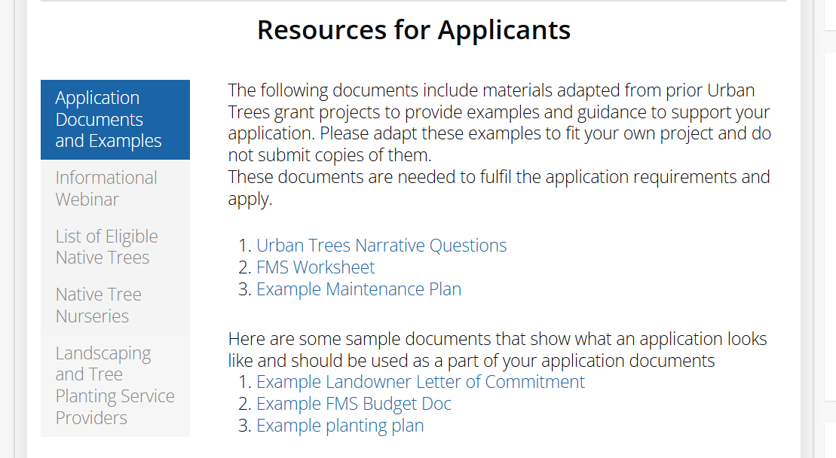
Program resources
Native Tree Guide
List of Tree Care Providers
List of Nurseries
Maintenance Plan Template
Examples of past projects
cbtrust.org

Slide 15
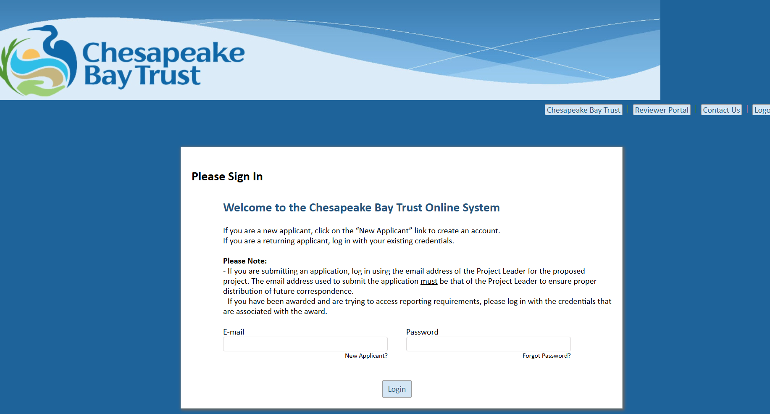
Application parts
1. Narrative: respond to questions in the RFP
2. Budget: https://cbtrust.org/grants/applicant-resources-forms-policies
3. Supporting documents
Planting plan
Landowner Permission
Letters of Commitment
2-Year Maintenance Plan
Contractor estimates
cbtrust.org

Slide 16
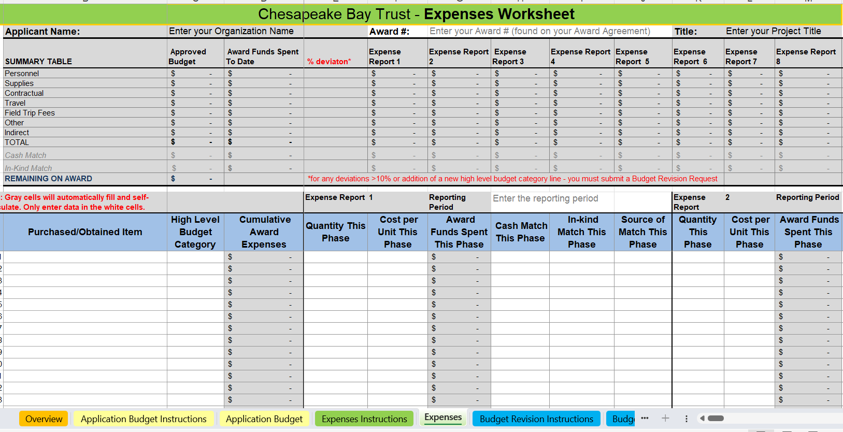
Eligible expenses
Supplies
Site preparation
Personnel costs
Other expenses and materials related to planning, implementing, and maintaining tree-planting projects in underserved areas
You can request up to $2,000 for community needs that indirectly support greening
Cost per tree = Total $ / # of trees
cbtrust.org

Slide 17
Evaluation
Your proposal will be evaluated by a Technical Review Committee on the following criteria:
1. Completeness of Application (5)
2. Project Plan and Likelihood of Success (50)
3. Budget (20)
4. Geographic Location (25)
cbtrust.org

Slide 18
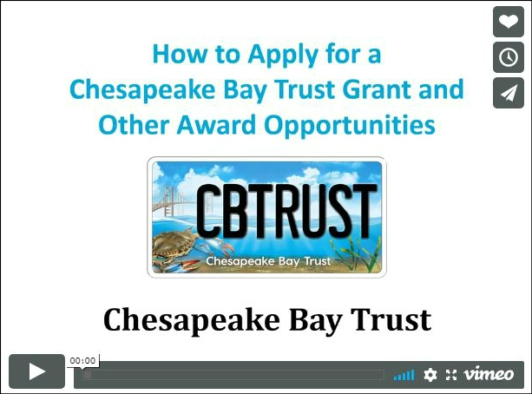
Watch our “How to Apply for a Grant” video
For a detailed and thorough explanation of the application process, view our “How to Apply for a Grant” video using this link: https://cbtrust.org/grants/
cbtrust.org

Slide 19
After submitting your application…
The Trust processes applications after the deadline
The Technical Review Committee (TRC) reviews the applications
The TRC’s recommendations are presented to the Trust’s Board of Trustees for approval
The Trust sends out decision letters by email to the applicant
You should expect to be notified by July
If awarded:
If declined:
Review, sign, and submit the award agreement, review and submit the award’s requirements, and complete the work outlined in the application
Reach out to the Trust to schedule a debrief. The Trust will provide a summary of the TRC feedback and recommendations on how your application could be improved and resubmitted to a future program.

Slide 20


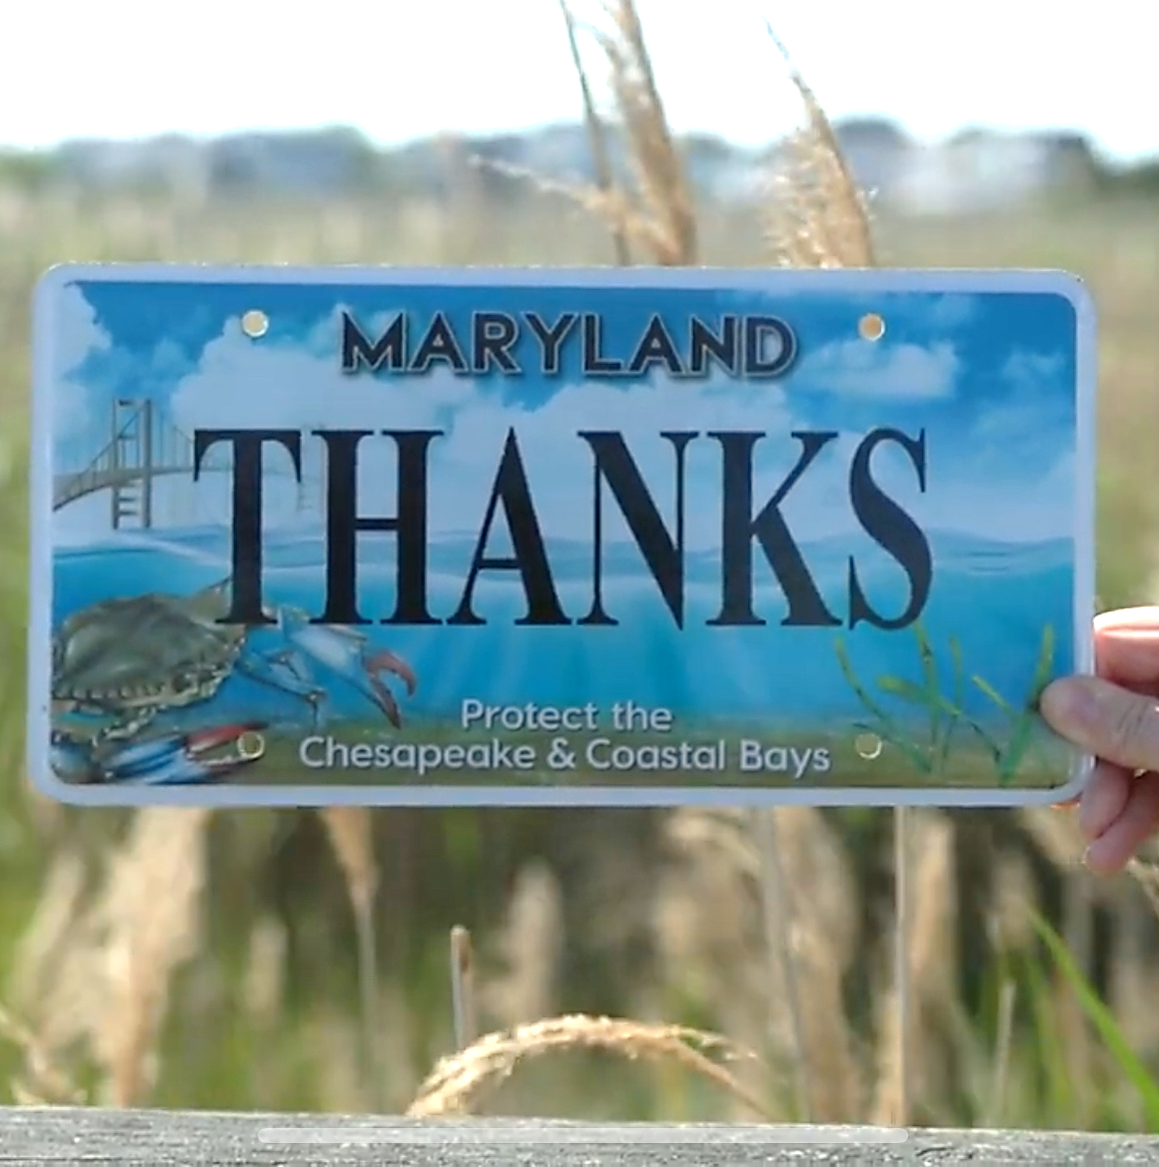
Lianna Gomori-Ruben
Urban Trees Senior Program Officer
Lgomori-ruben@cbtrust.org
410-974-2941 ext 112
For more information visit
cbtrust.org

