Slide 1


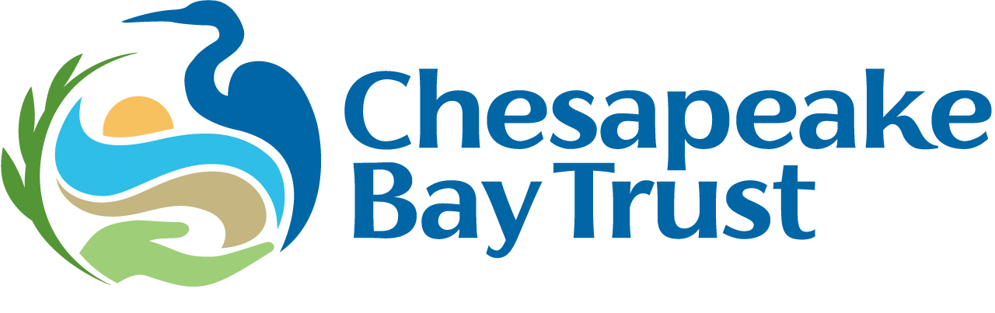
Prince George’s County Climate Resilience Technical Assistance
Grant Program
Information Session
September 2nd 12:00pm to 1:00pm
Presented by: Delaney Samons
Learn more at: https://cbtrust.org/grants/prince-georges-county-climate-resilience-hub-technical-assistance-provider/.
We will begin momentarily. This webinar will be recorded and posted on our website/shared with those who were unable to attend.

Slide 2
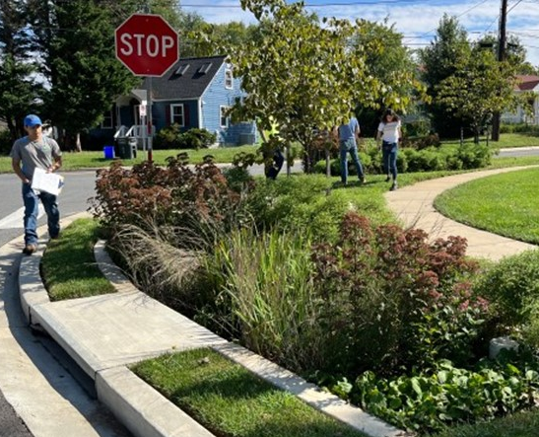
Agenda
  Welcome and Introductions
  Overview of the Community Resilience Hub Program
  Overview of the Climate Resilience Technical Assistance Program
  Program Timeline
  Application Process & Resources
  Questions and Answers
  Conclude, any last questions!

Slide 3
Introductions
The Chesapeake Bay Trust is a nonprofit organization. Our mission is to engage and empower diverse groups to take actions that enrich natural resources and local communities of the Chesapeake Bay region.
Prince George’s County Department of the Environment works for a healthy, beautiful, and sustainable County through programs that provide climate resilience, flood control, clean water, trees, recycling and waste management, litter prevention, animal services, and pet adoption in partnership with residents and other stakeholders.

Slide 4
Climate Action Plan
Climate Action Implementation Strategy Plan (CAISP) Resilience Hubs (Adaptation Implementation Strategy 8)
Three County Resilience Hubs and Resilience Hub Framework
1 2 3

Slide 5
Background, Goals, and Priorities
Prince George’s County Program Goals
Prince George’s County communities have faced increased threats as the climate changes: more severe rain events that cause flooding and power outages, more frequent and persistent excessive heat events that threaten human health, livelihoods and food security, and more.
Goal: Prince George’s County, as recommended in both its Climate Action Plan (CAP) and Climate Action Implementation Strategy Plan (CAISP), aims to create Resilience Hubs to support everyday community needs and assistance during times of disruption and periods of recovery.

Slide 6
Climate Action Plan
Climate Action Implementation Strategy Plan (CAISP) Resilience Hubs (Adaptation Implementation Strategy 8)
Three County Resilience Hubs and Resilience Hub Framework
Community Resilience Hub Grant Program Supporting Community-based Climate Resilience
1 2 3 4

Slide 7




What is a Climate Resilience Hub?
Resilience Hubs are trusted community-serving facilities that complement emergency facilities by serving coordination points for communication, distributing resources, building community cohesion, and advancing climate mitigation and adaption goals year-round.

Slide 8
Eligible Resilience Hub Projects
Services and Programs
Communication Equipment
Buildings and Landscaping
Power Systems
Operations
If you have a project idea that does not directly fit into the high-level categories but meets the broader goals of this grant program, contact Trust staff to discuss your idea before applying.
Notes:
DS

Slide 9
Eligible Resilience Hub Projects
Resilience Hubs must have a permanent or mobile site offering services under one or more of the high-level project categories. This can include the following projects examples:
Educational workshops on flood preparedness and related climate resilience topics
Upgraded communication equipment for sharing alerts and/or resources during times of need
Installing native shade trees and vegetable gardens to offer shade and provide food
Installing renewable energy
Community data collection and plan development for operationalizing a climate relief plan
If you have a project idea that does not directly fit into the high-level categories but meets the broader goals of this grant program, contact Trust staff to discuss your idea before applying.
Notes:
DS

Slide 10
Climate Action Plan
Climate Action Implementation Strategy Plan (CAISP) Resilience Hubs (Adaptation Implementation Strategy 8)
Three County Resilience Hubs and Resilience Hub Framework
Resilience Hub Support and Peer to Peer Countywide Resilience Hub Network via Technical Assistance Provider
Community Resilience Hub Grant Program Supporting Community-based Climate Resilience
1 2 3 4 5

Slide 11
Grant Program Overview
Funding Available:
Deadline: Thursday, October 1st at 4pm
Find the Request for Proposals, online application, resources, and more on the program page at: https://cbtrust.org/grants/prince-georges-county-climate-resilience-hub-technical-assistance-provider/.
Eligible Applicants: Public and Independent Higher Educational Institutions; Nonprofit Organizations; Watershed Organizations; Community Associations; Faith-based Organizations; Prince George’s County Municipalities; and Climate Resilience and/or Emergency Preparedness Organizations. Applicants that are not based in Prince George’s County must have a Prince George’s-based partner, the role of which should be clearly articulated in the proposal and in a Letter of Commitment from that partner.
~$150,00 for FY27 (We anticipate one awardee, though we will consider dividing work across multiple awardees.

Slide 12
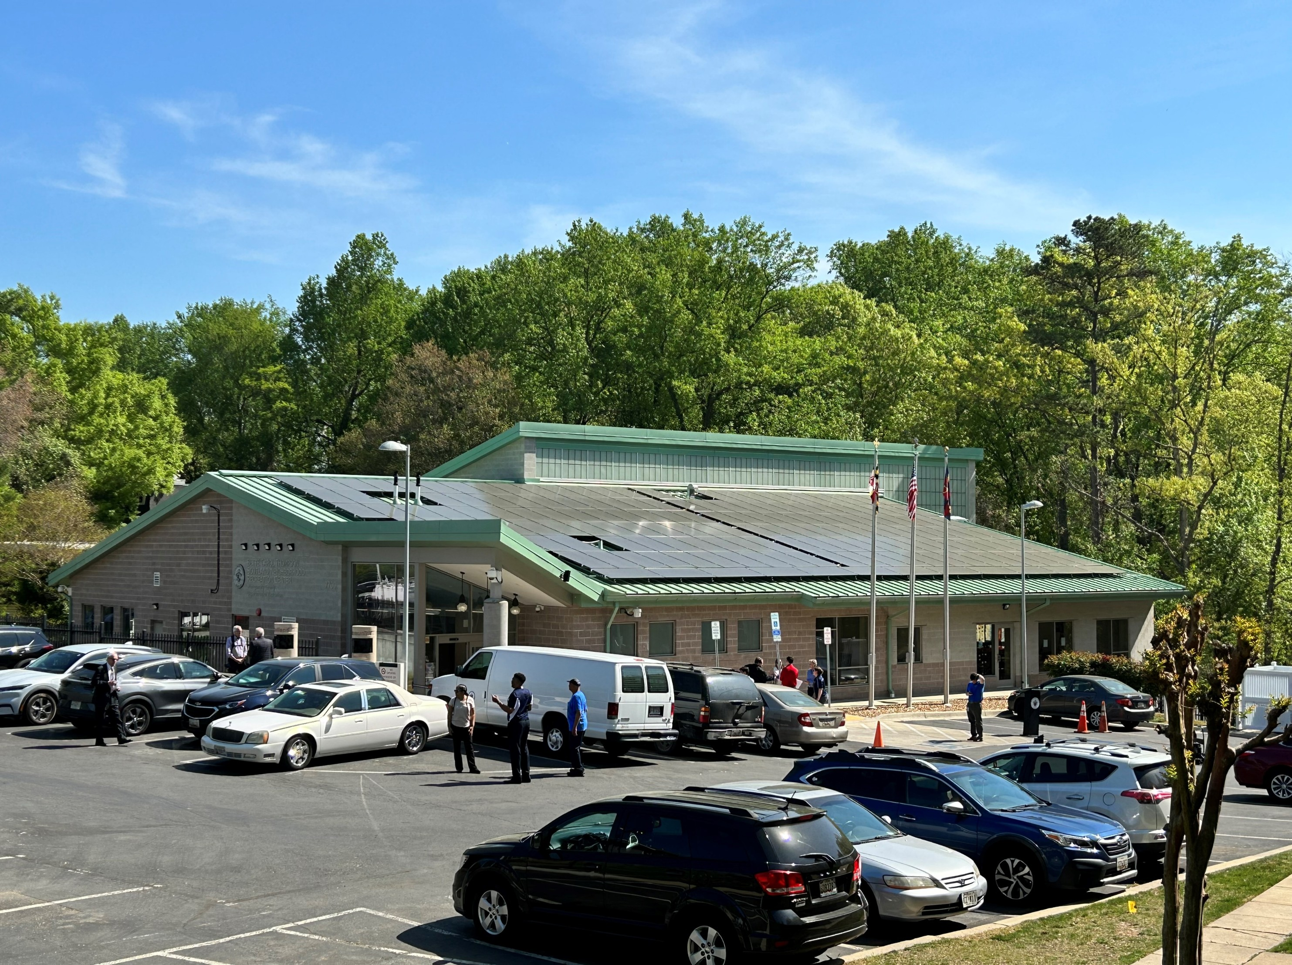
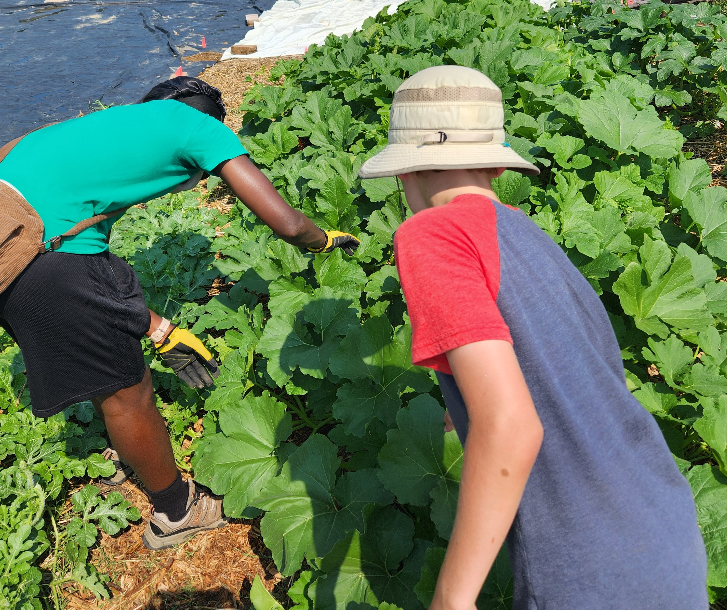
Program Overview
We seek Technical Assistance providers to:
1. Provide technical and organizational support for individual Resilience Hubs and/or
2. Create and provide support for a peer-to-peer Countywide Resilience Hub Network.
Applicants may apply to provide support for one or both scopes of work. We anticipate one awardee for scopes 1 and 2, though we will consider dividing the work across multiple awardees.
12

Slide 13
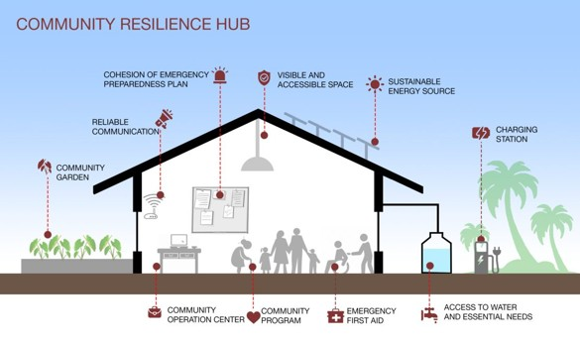
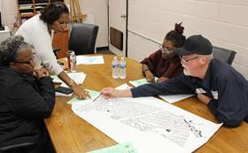
Scope of Work #1:
Provide technical and organizational support for individual Resilience Hubs
1A: Assist with technical implementation of the Resilience Hubs:
  Develop/refine an implementation plan;
  Help with procurement of goods or services, feasibility studies, permitting, and developing staffing solutions;
  Develop a sustainability plan; and
  Assist with organizational capacity of the Resilience.
Note: Resilience hubs will be offered the option of support from a Technical Assistance provider; however, resilience hubs are not required to receive support.
13

Slide 14
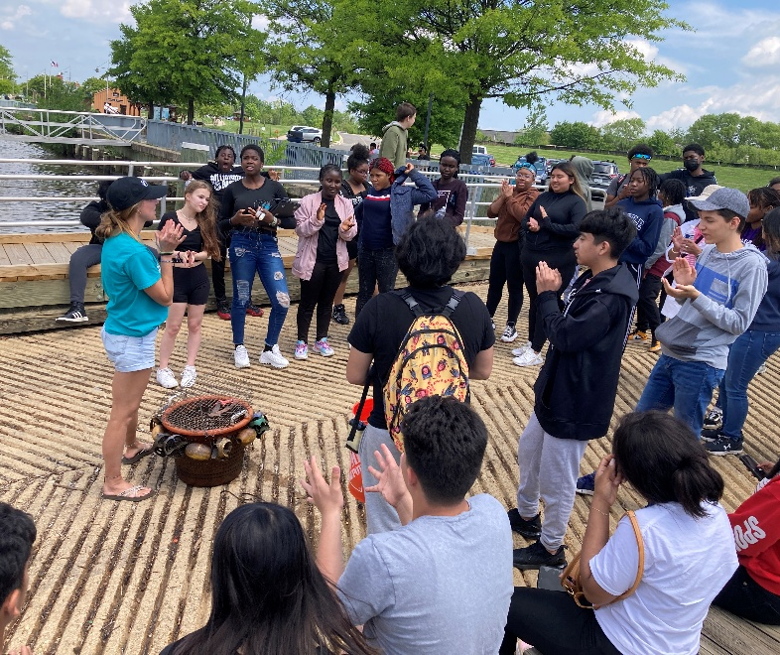
Scope of Work #2:
Create and provide support for a peer-to-peer Countywide Resilience Hub
The network will be comprised of the 15 resilience hubs awarded through the Prince George’s County Community Resilience Hub Grant Program and the two to three previously selected County-facilitated pilot resilience Hubs.
Goals of the resilience network:
  Foster sharing of resources and cost efficiencies and
  To leverage other opportunities such as joint purchasing agreements and funding opportunities.
14

Slide 15
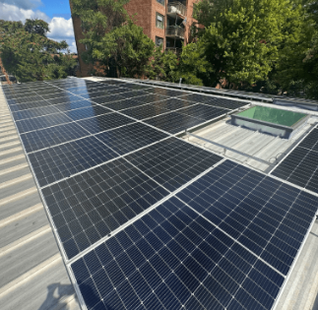
Expected Outcomes of Technical Assistance
Increased understanding of resilience hubs and increased capacity of the identified target audience(s);
Implementation of one or more features of the resilience hub;
Deployment of the individual resilience hubs; and
Launch of a Countywide Resilience Hub Network.
15
Notes:
DS

Slide 16
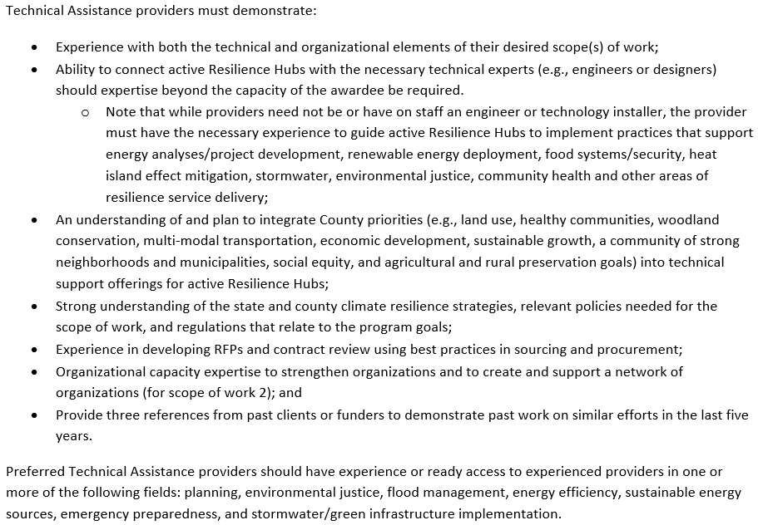
Qualifications and Experience
Notes:
DS
Photo from project - 19776

Slide 17
Program Timeline and Overview
Program Deadline, 4pm EST
Funding decision made and letter(s) sent out
Program opened on August 13th, 2026
September 2nd, 2026
October – November 2026
December 2026
August 2026
October 1st, 2026
November – December 2026
Information Session
Review process and Technical Review Committee Meeting
Project begins

Slide 18
Questions?
Notes:
DS

Slide 19
Application Process
Read the Request for Proposals (RFP)
Schedule a meeting/call with us
Identify project partners
Compile application pieces
Send a draft of your application to us for feedback
Submit the online application
SUBMIT EARLY!
We strongly encourage applicants to submit a few days prior to the deadline given the potential for high website traffic on the due date. The Trust cannot guarantee availability of online system technical assistance on the due date.

Slide 20
Application Pieces
Narrative
Supporting Documentation
Budget
Download and answer the required narrative questions
Linked on the webpage: https://cbtrust.org/grants/prince-georges-county-climate-resilience-hub-technical-assistance-provider/
Gather supporting documentation
Letters of Commitment
References
Condensed portfolio of completed work in this field
Other relevant items
Obtain cost estimates to build your budget
Use the budget form directly located in the application form to complete your application budget.
Provide budget justification.
Note: We are no longer using the financial management spreadsheet.
Notes:
KS
DS – add notes

Slide 21
Tips for a Strong Narrative
Be detailed and clear
Demonstrate a project need
Add background but focus on the project
Answer each applicable question
Reviewers are your audience – don’t assume prior knowledge of any part of your project
Use font size, bullets, headers, text boxes and other tools to visually organize and emphasize key points

Slide 22
Winning Factors
Alignment with program and community priorities
Community buy-in and support
Reasonable and accurate budget that aligns with narrative
Qualified and appropriate partners
Clear focus
Well-supported methodology
Project readiness to proceed!

Slide 23
Tips for Success
Contact Trust staff early
Check deadlines & eligibility criteria
Follow the online instructions and submit all required components (narrative and budget)
Review the Evaluation Criteria section in RFP
Details, details, details!
Letters of Commitment
Landowner permission
Notes:
KS

Slide 24
After Submitting Your Application…
The Trust processes applications after the deadline
The Technical Review Committee (TRC) reviews the applications
The TRC’s recommendations are presented to the Trust’s Board of Trustees for approval
The Trust sends out decision letters by email to the applicant
If awarded:
If declined:
Review, sign, and submit the award agreement, review and submit the award’s requirements, and complete the work outlined in the application
Reach out to the Trust to schedule a debrief. The Trust will provide a summary of the TRC feedback and recommendations on how your application could be improved and resubmitted to a future program.
Notes:
Each application is reviewed by a technical external peer review committee, called the Technical Review Committee (TRC), comprised of individuals who are experts in the fields supported by the RFP and represent communities engaged by projects funded by the RFP.
The TRC ranks and scores all applications based on the criteria listed in the “Evaluation Criteria” section of the RFP and then meets to discuss the application merits.

Slide 25
Questions?
Notes:
DS

Slide 26
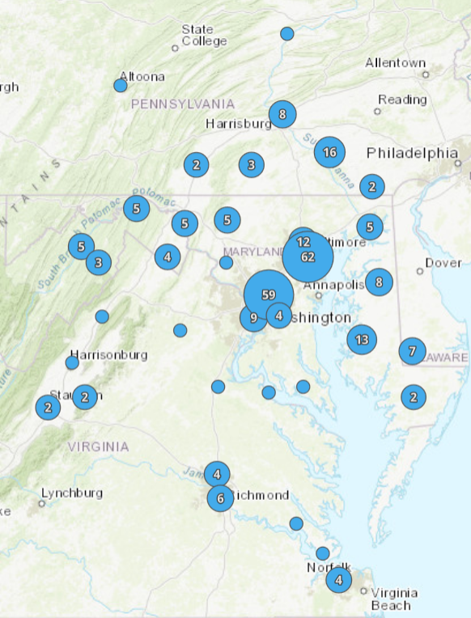
Learn More about the Trust’s Previously Awarded Projects
Chesapeake Bay Trust
Awarded Projects Map:
https://cbtrust.org/impact-of-our-work/
Notes:
DS – done
- if they want to see more projects, they can go to impact of our work
- CBT Awarded Projects Map – Impact of our work page – features all of the Trust projects and you can filter by grant program

Slide 27

Contact
Delaney Samons
dsamons@cbtrust.org
410-974-2941 x131
Register for Office Hours
Wednesday, September 16th, 12pm to 1pm
Register here: https://us02web.zoom.us/meeting/register/i1w_b5F5SHqlSLv1i4DgAg
Thank You!
Any Questions?

